Slide 1
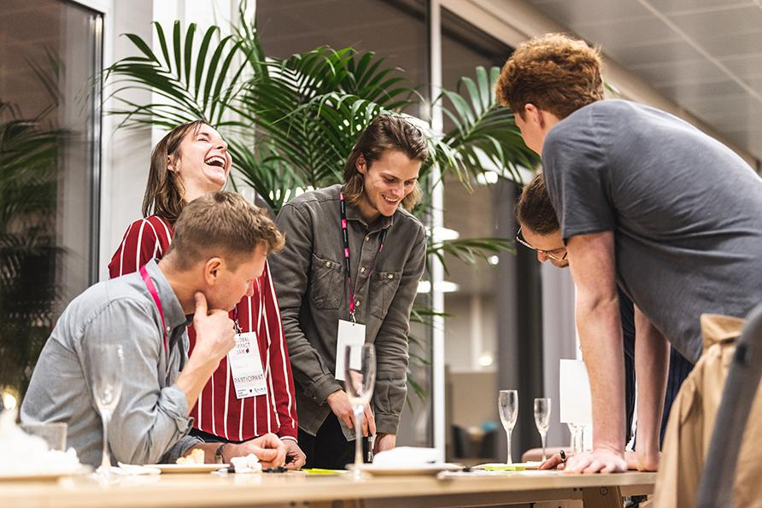
LINKÖPING SCIENCE PARK
progress report 2025

Slide 2
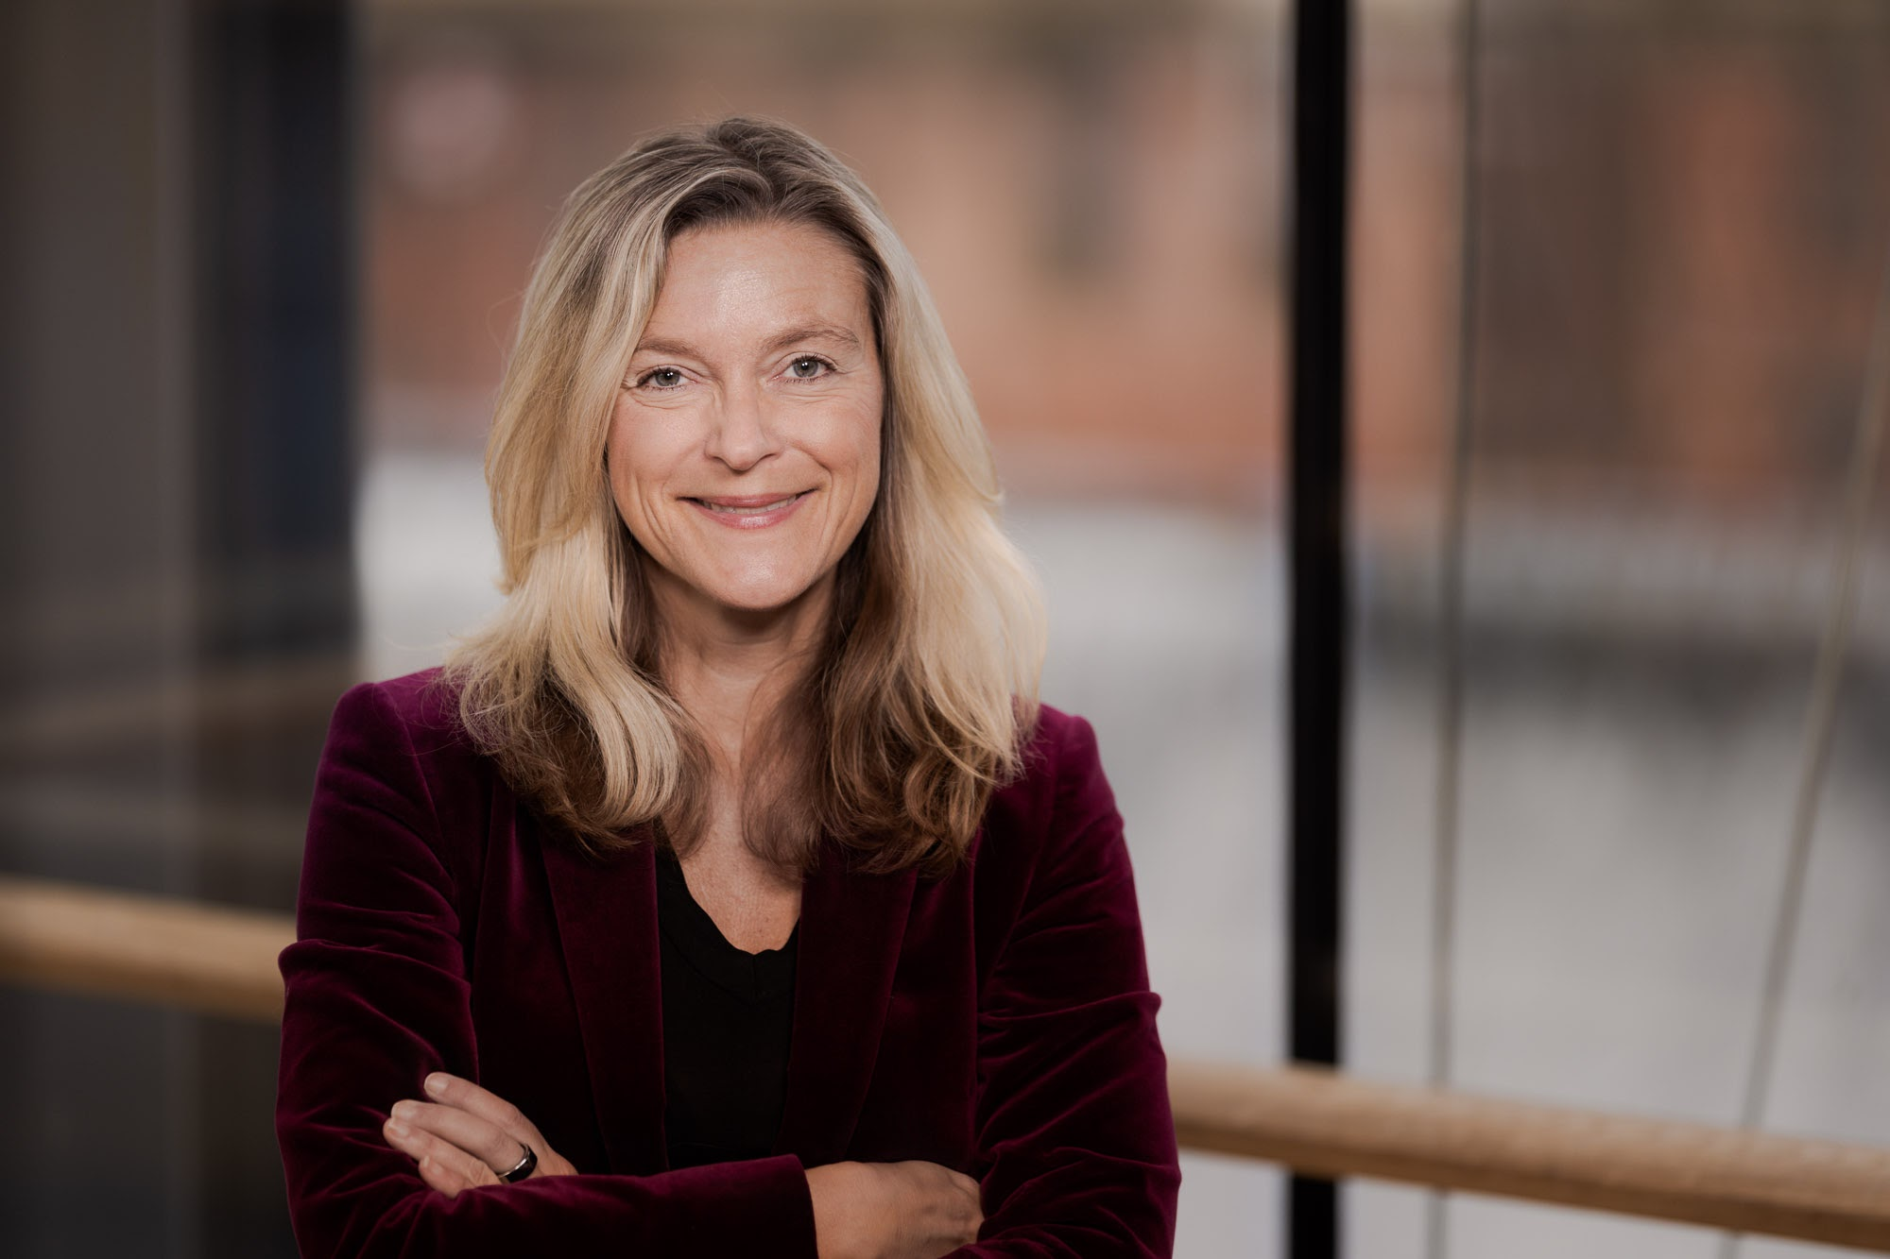
Summing up 2025…
In 2025, Linköping strengthened its position as tech hub. Linköping Science Park contributed to an increased business growth and fostered a more dynamic innovation climate through a record number of business engagement.
Through clusters, test environments and strategic connections, we strengthened technology transfer and empowered more companies to transform new technology into business faster.
Investments in deeptech, AI and security boosted innovative power and international awareness. At the same time, our talent initiatives broadened participation and enhanced digital competence for more groups.
In conclusion, 2025 shows a science park driving transformation and competitiveness in practice.
Lena Miranda CEO, Linköping Science Park
Notes:
På svenska:
2025 stärktes Linköpings position som tech-hub, där Linköping Science Park bidrog till ökad företagstillväxt och ett mer dynamiskt innovationsklimat genom rekordmånga företagskontakter.
Genom kluster, testmiljöer och strategiska kopplingar har vi stärkt tekniköverföringen och fått fler företag att snabbare omsätta ny teknik i affärer.
Satsningar inom deeptech, AI och säkerhet har ökat innovationskraften och den internationella synligheten.
Samtidigt har våra kompetensinsatser breddat deltagandet och stärkt den digitala förmågan i fler grupper.
Sammantaget visar 2025 en Science Park som driver omställning och konkurrenskraft i praktiken.

Slide 3
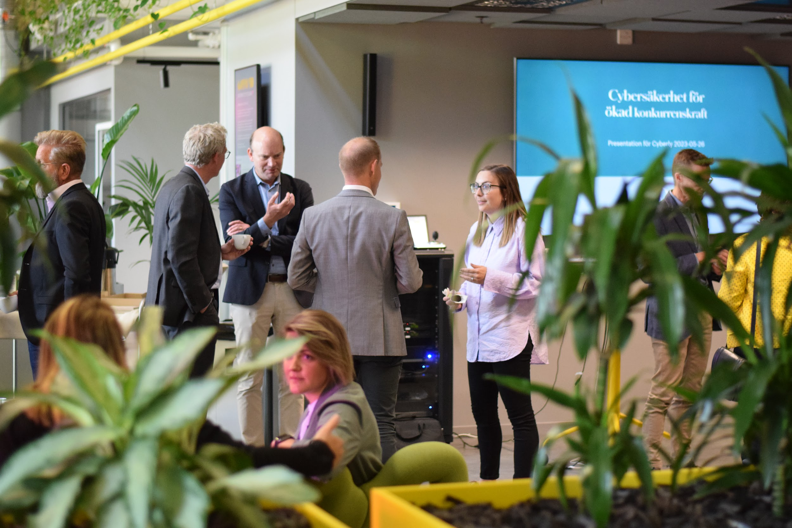
Linköping and East Sweden remains a strong tech hub

Slide 4
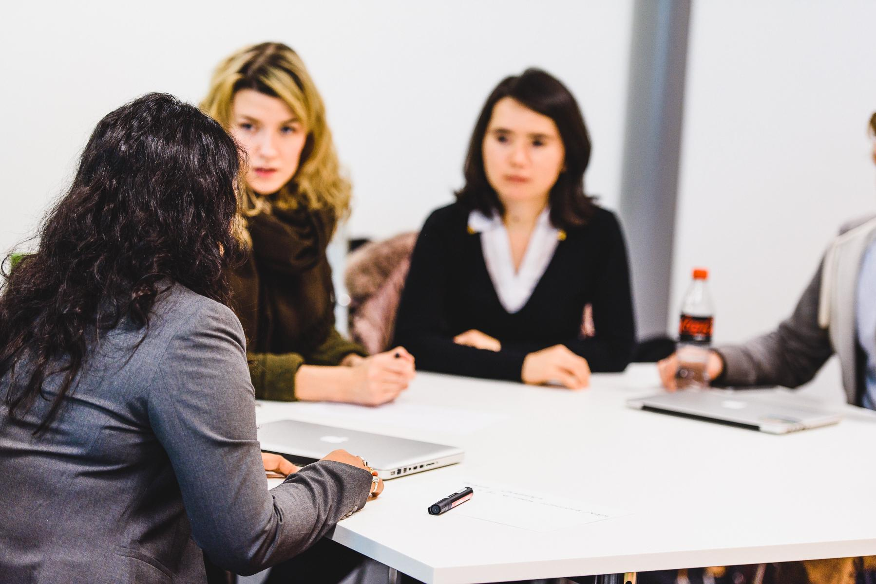
+550 tech jobs
in Linköping 2021-2023
13 850 people
in the tech sector in Linköping 2021-2023. Equals 20% of all employees in the private sector.
644%
Growth in the Tech Sector
in East Sweden 2000-2022
39 billion
in turnover for the tech industry in 2023, which corresponds to 25% of the total turnover in the private sector.
27% more R&D
Linköping’s share of R&D related businesses and operations, the Swedish average is 13%.
Source: TechSverige

Slide 5
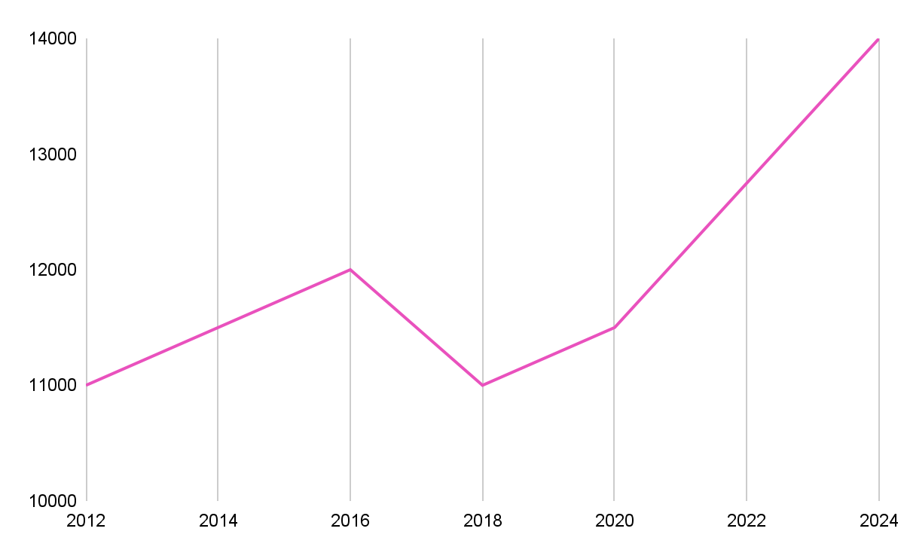
22 %
27%
RnD in Linköping
of Linköping's total revenue in the private comes from the tech industry.
13%
Development of the number of employees in the tech industry in Linköping
68 134
RnD in Sweden
SEK 39 bn
SEK 139 bn
13 850
Total private sector business turnover in Linköping in 2023 was SEK 178 billion.
1 in 5 employees in Linköping work in the tech industry.
Other industries
Tech industry
Source: Näringsliv och tillväxt, Linköpings kommun

Slide 6
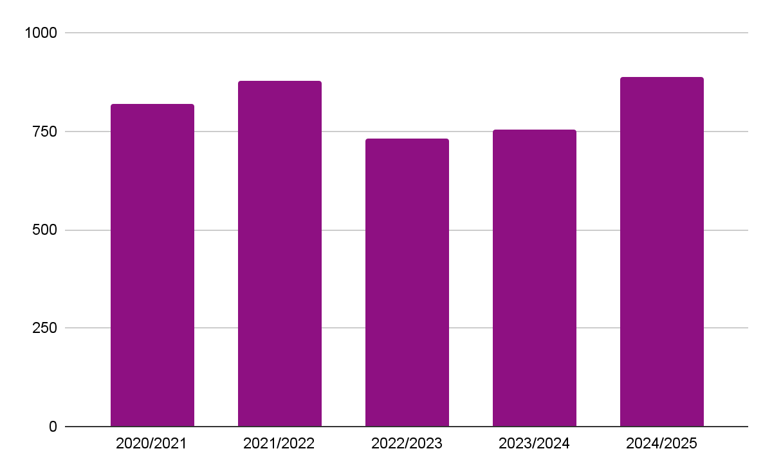
A world-class university right next door
8,000 new engineers in ten years – powered by Linköping University
Sweden’s fifth largest university by number of registered students – 40,000+ students across 4 campuses.
Ranked among the world’s top 201-250 universities by Times Higher Education 2025, with several programs placed in the top 100 by various organizations.
Allocation of a European AI Factory, Mimer.
Number of graduates with a Master of Science in Engineering and a Bachelor of Science in Engineering per year

Slide 7
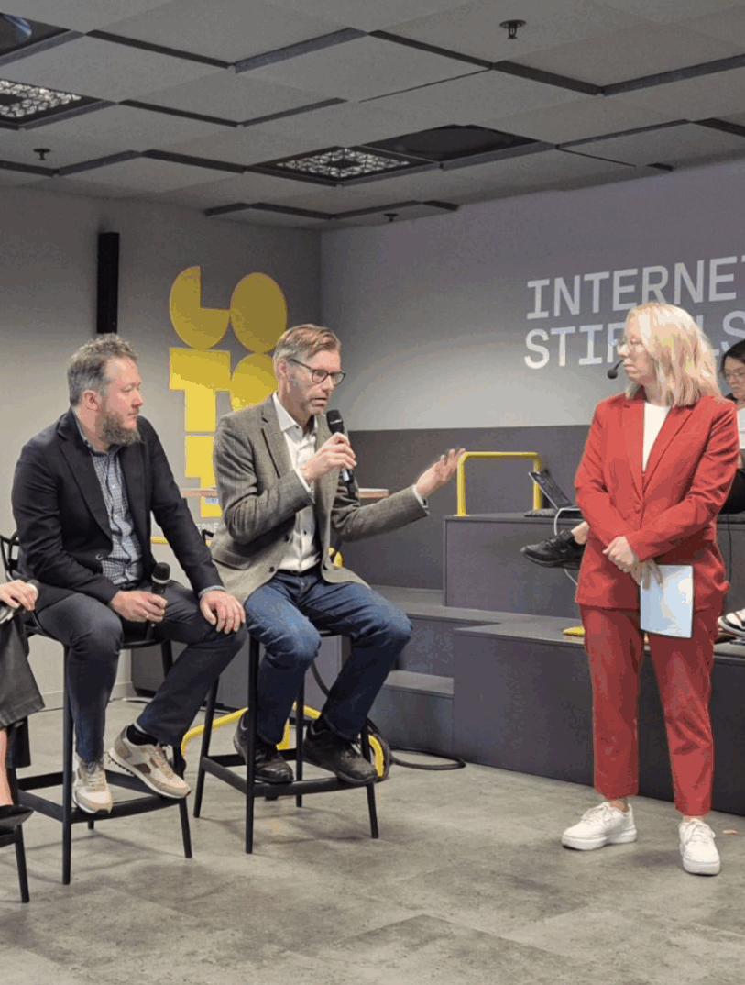
“Internships lower the threshold – they let both sides evaluate each other for future careers.”
- Claes Lundström, Sectra.
Unlocking Sweden’s hidden innovation potential through strategic university-industry partnerships
Sweden has thousands of skilled PhD students – but few structured internships. At the Academia-Industry Collaboration Forum, voices from academia, industry and government explored how internships can strengthen collaboration and spark innovation.
The message was clear: PhD internships are more than career steps – they’re keys to long-term impact.

Slide 8
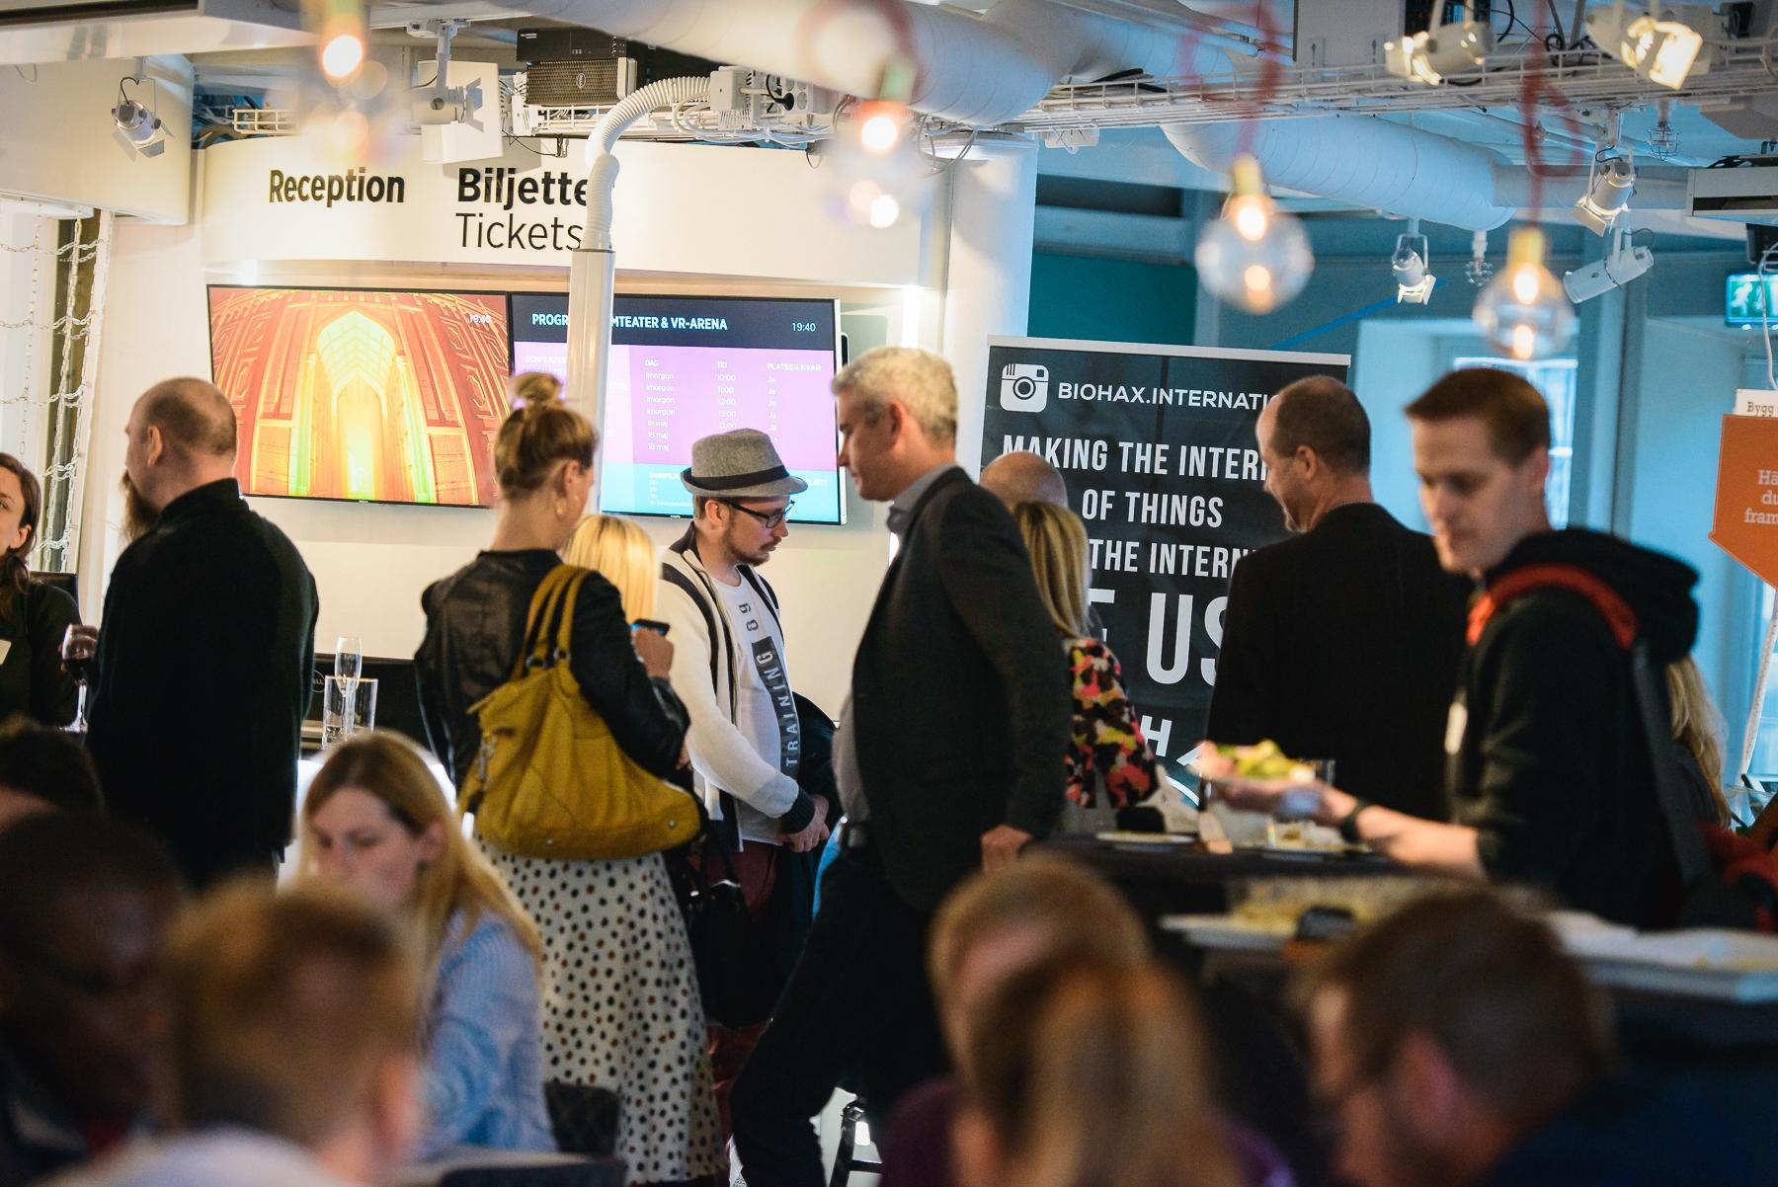






Major establishments during 2023-2025
Väderstad R&D Center
Manta
Toyota Innovation Center
Swisslog R&D Center
Sferical AI
Notes:
Signifikanta etableringar

Slide 9
Meetings that matter
"Thank you for the warm welcome! I am impressed by the dynamic in Linköping! The city’s ability to create an ecosystem that brings together industry, research, and academia is remarkable. This collaborative approach is not only inspiring — it represents a true competitive advantage to attract talent, accelerate innovation, and develop sustainable solutions.”
- Jean François Calmels, Deputy General Manager Actia Group
During 2025, we have had the pleasure of welcoming a wide range of guests to Linköping. Among them were business representatives, including corporate management teams from Vantor, Sigma Technology IT Group, and Actia Group, as well as various representatives and ambassadors.
We have also welcomed international country and city representatives from several parts of the world, including Malaysia, Sri Lanka, Spain, Japan, China, Austria, and Taiwan, highlighting the strong global interest in Linköping as a hub for innovation and collaboration.
Last but not least, we have hosted representatives from other Swedish regions, further strengthening national cooperation and the exchange of knowledge and experience.
“Thank you for a great meeting. Linköping is a region with strong forward momentum. Sigma will do everything we can to help continue this journey of growth.”
- Johan Edlund, CEO Sigma Technology IT Group AB

Slide 10
Operational overview 2025

Slide 11
Highlights from 2025: new initiatives, growing clusters, and a stronger organization
Part of Work in Sweden - facilitating work group
IndX is growing as a national innovation arena
Progress in digitalization through clusters and skills initiatives
Defense Hub Sweden launched
Hosting Aerocspace Cluster Sweden - East Node
Facilitating the iCapital innovation fund within Linköping municipality
New organization and team structure in place

Slide 12
30
number of projects
60 since 2020
In 2025, we ran or took part in 30 different projects.
Most of them operated on a national level – but always with a local heartbeat. We believe in working locally in ways that inspire nationally, and nationally in ways that create real value for our local communities.

Slide 13
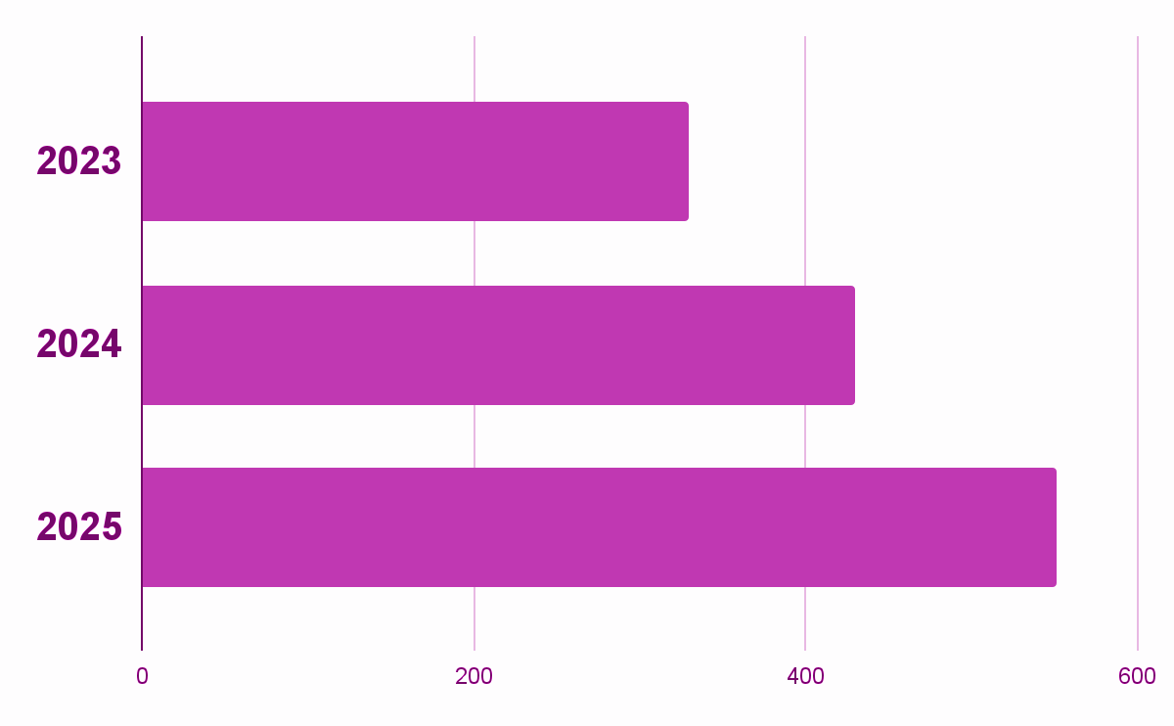
More companies - stronger impact
329
430
We meet companies where they are – that’s our promise. And we’re now meeting more than ever. Since 2023, we’ve expanded our capacity to support 100 more companies every year.
That’s impact in action.
551

Slide 14
Supporting company growth
30
+214%
Companies in the accelerator process (23).
Average revenue increase among participating companies in East Sweden since 2016.
+606
+105
Number of jobs created by participating companies in East Sweden since 2016.
Number of companies that have participated in Swedish Scaleups via Linköping Science Park since 2015.
+
New civil-military module within Swedish Scaleups.
Notes:
Ta bort + före 606 och 105?

Slide 15
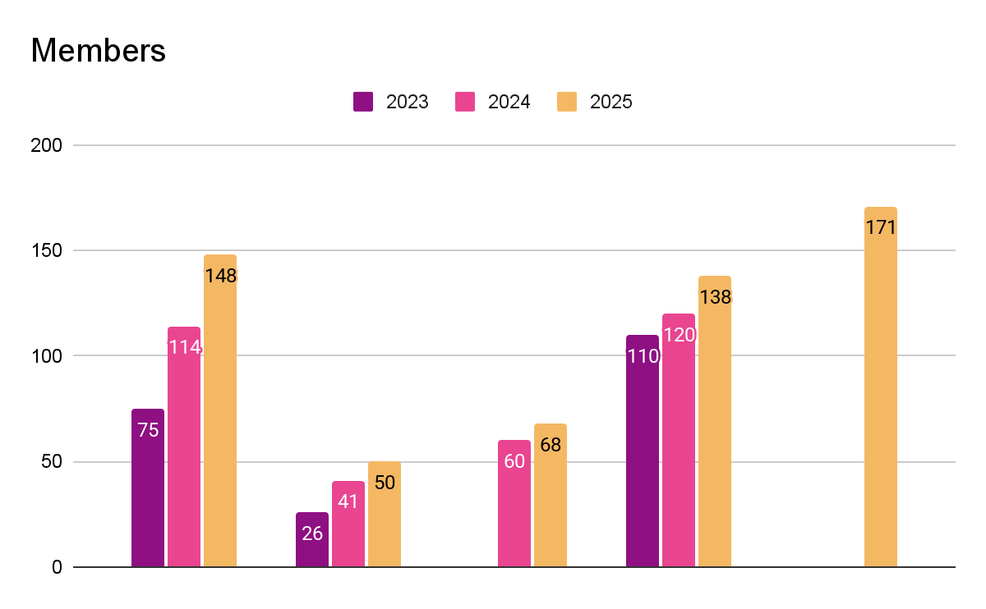



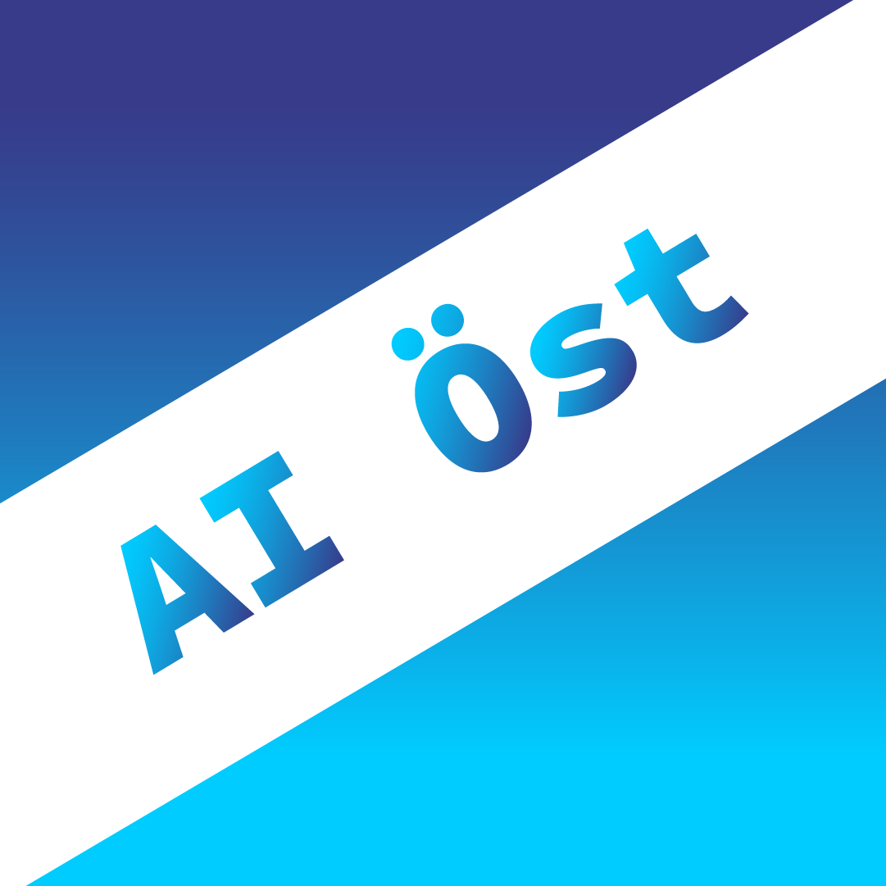

Growth within
our clusters
*
*Members in AI Öst consists of individuals while the other clusters have a membership base of companies/authorities.

Slide 16
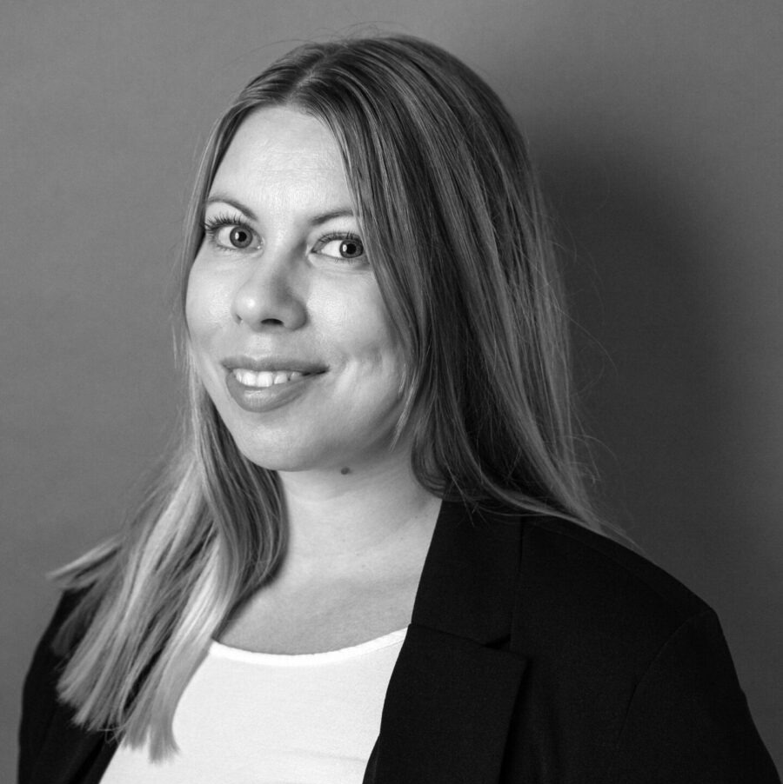

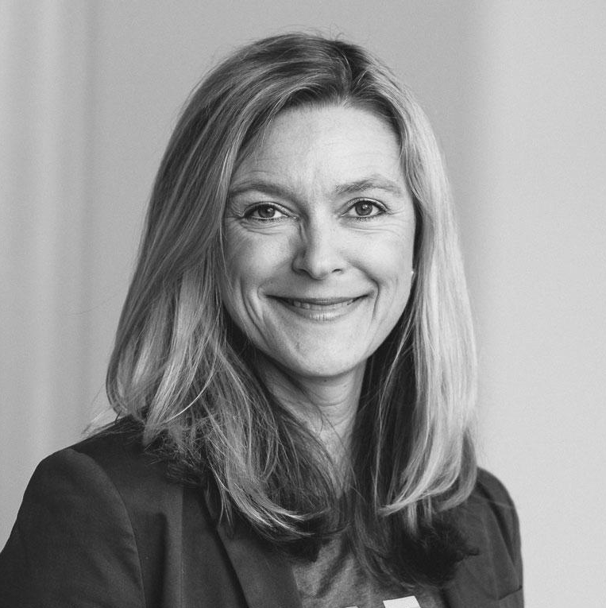



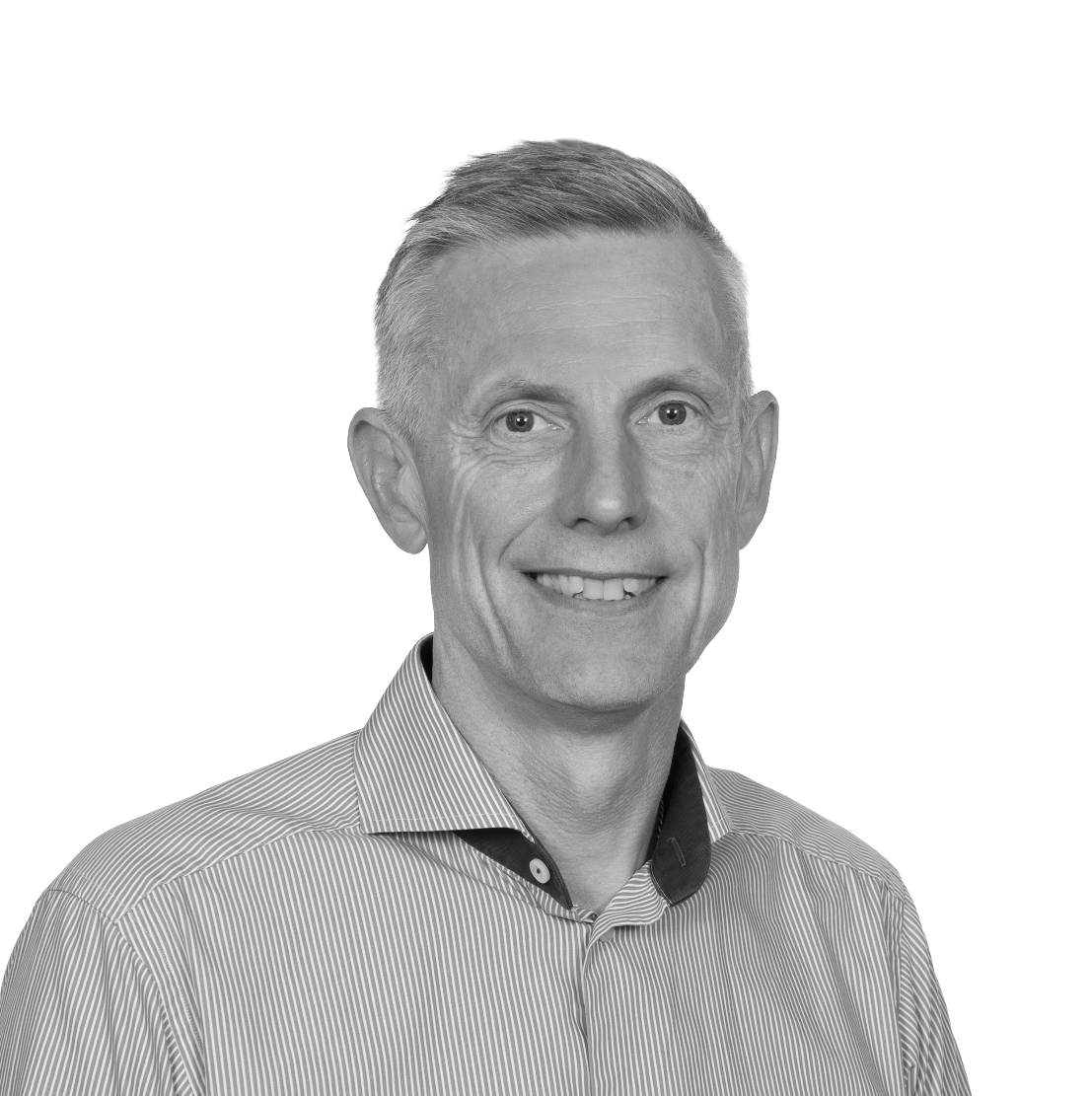
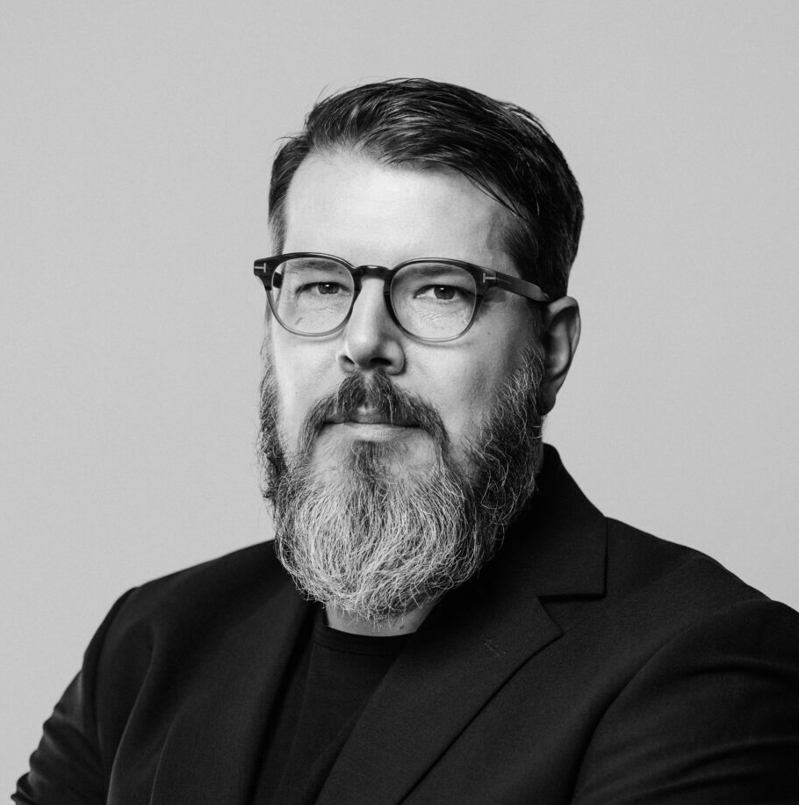
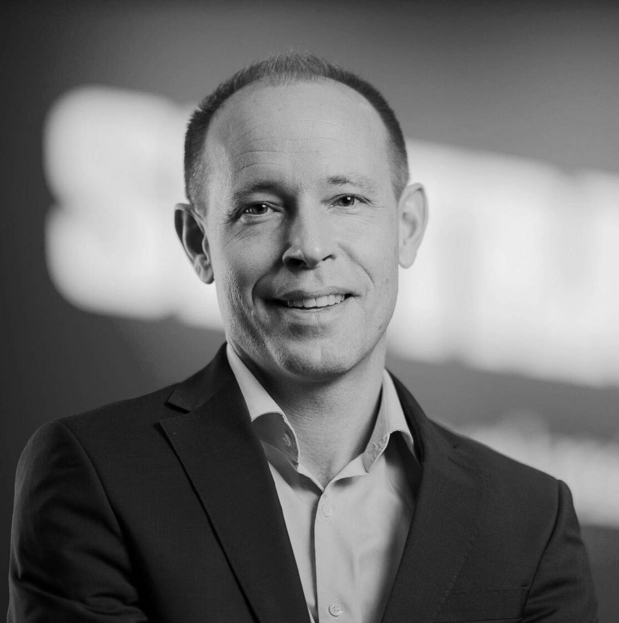
Ecosystem
95%
Cyberly
Member satisfaction
Enabling a safe, sustainable and efficient society by enhancing digital resilience.
30
Academia / Research
Beatrice Magnusson
Project Manager
Events: networking, cluster member events, work forces SOC and CISO (30 participants per event on average)
“No one builds digital resilience alone. In our cluster, we bring together the strengths of companies, government partners and research – making sure society stays strong, today and tomorrow."
7
43
982
Lena Miranda
CEO, Linköping Science Park
Government organizations
Member
companies
Newsletter subscribers
“Linköping has strong cybersecurity competence built around Linköping University’s leading research and education, combined with a mature tech ecosystem, defence-related expertise, and practical SME-focused initiatives in and around Linköping Science Park.”
100+
Intensified collaboration with authorities, now eligible to become Cyberly members.
Cybersecurity providers Cybersecurity users Cyber consultancies
Participants in the introductory course in cybersecurity, in collaboration with Sweden Secure Tech Hub
Conny Ljungqvist, Link22, cluster member
“Cyberly manages to gather the strength of our region when it comes to cyber security. It puts the region on the map and attracts people, which is vital for our long-term success.”
Leif Nixon, Combitech, cluster member
“Through Cyberly we can help each other, exchange experiences, and get to know one another. In day-to-day work, having these contacts is very valuable on a purely operational level.”
Magnus Skogberg, Sectra Communications, cluster member
“We can be truly proud of many highly capable cyber security actors in our region and through Cyberly we catalyze collaboration and work for increased digital resilience in society."

Slide 17





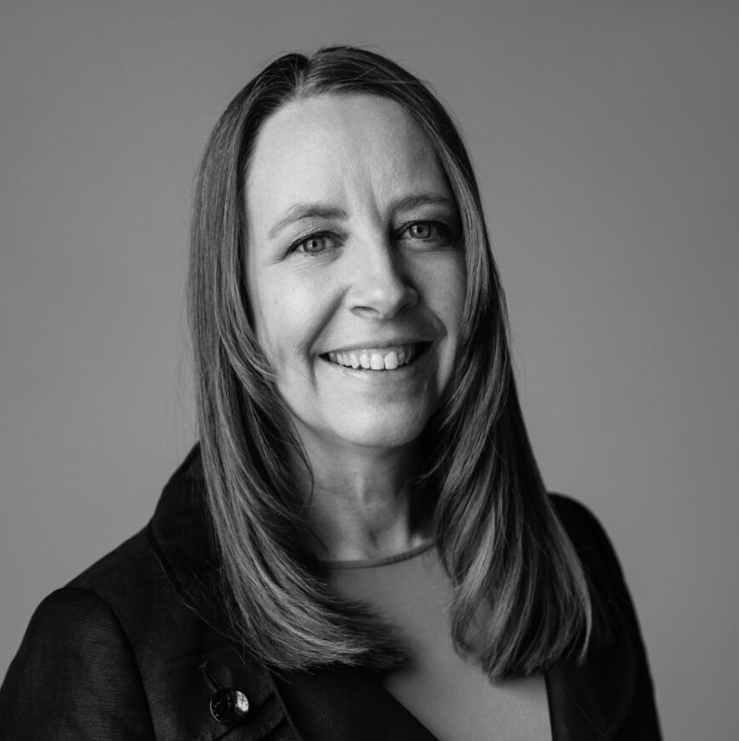



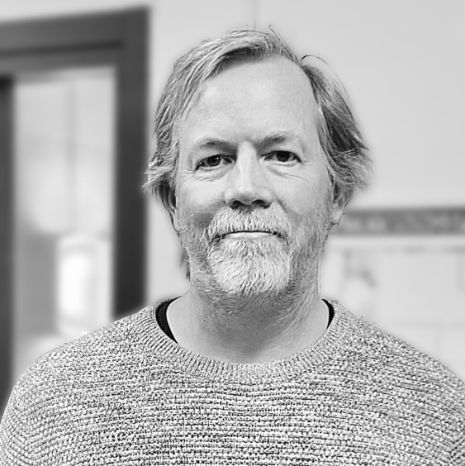







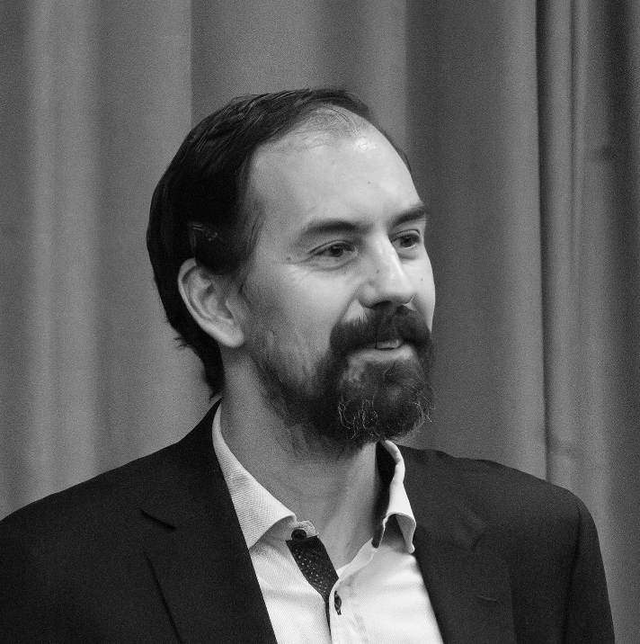
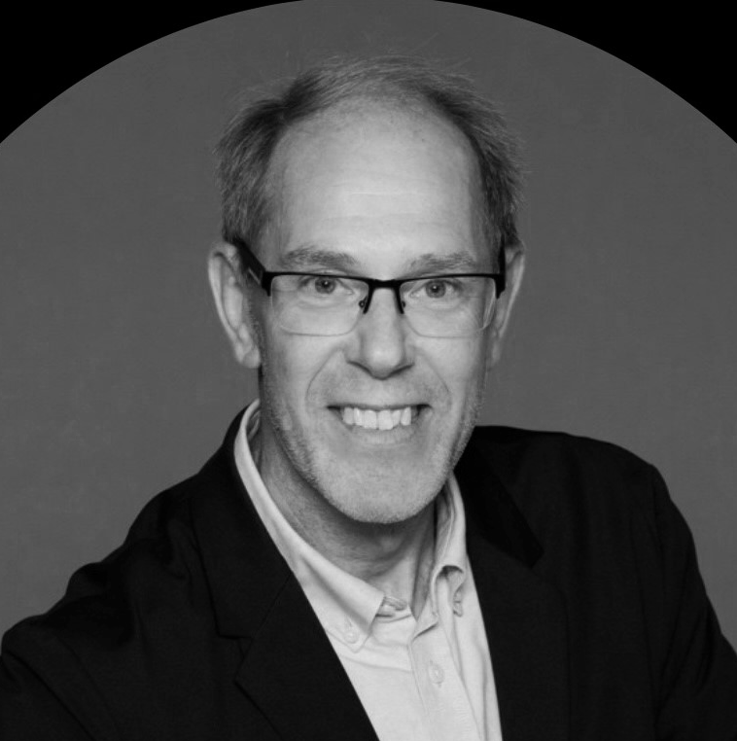
88%
Nodes & partners
IoT World 2025
Member satisfaction
Accelerating the use of solutions for Internet of Things for a sustainable future.
29
Events (30 participants per event on average)
Ulrika Johansson
Project Manager
150
“By bringing together and scaling regional excellence, we can build a long-term and sustainable national platform. Sweden is a large country, and we need
to work together.”
Member organizations (239 Unique participating organizations on our events)
Tomas Westlund
Technical Coordinator and Lab Manager
11
“Smart devices that can collect information and communicate with each other are changing power structures. There is a need for meaningful dialogue about how we preserve, and preferably strengthen, democratic structures in these processes of change.”
Projects 2018-2025 (Note: only the IoT World projects for which Linköping Science Park has received funding. In addition to these, RISE and various members have had IoT World projects).
1107
768
Linkedin followers
Newsletter subscribers
Increased
Göran Berglund, Tre Sverige, IoT World member
“The partnership provides us with a platform for collaboration, knowledge exchange, and the opportunity to help strengthen IoT expertise across the entire country.”
Christian Sahlén, Actia, Iot World member
“Connecting people is important, that’s when you can find the things that create magic. It’s a good approach to organize that type of event, where you set aside an hour and simply meet.”
international focus through the ElektroLink project

Slide 18




National
Regional
Local
Switch to Sweden
IoT World
Code Summer Camp
Defense Hub Sweden
Kunskapsnavet för lantbrukets digitalisering
Semiconductors- a swedish value chain
R2R-HET -Rulle-till-Rulle Hybrid Tryckt Elektronik Tillverkning
Elektrolink
Sweden Secure Tech Hub
IndX
Visual Sweden
The Insider’s Guide to Recruiting International Talent
The Insider’s Guide to Moving and Living in Sweden
Water Wise Societies
Digital kompetens för företagens konkurrenskraft
Digital kompetens för offentlig sektor
Avancerad digitalisering för SMF
Kraftsamling AI Öst
STIM Energiinnovationer
Swedish Scaleups
Cyberly
iCapital innovation fund
Brilliant Mentors of the Future
Linköping Climate Neutral
Big picture thinking, local-level impact
Notes:
Rubrik?

Slide 19
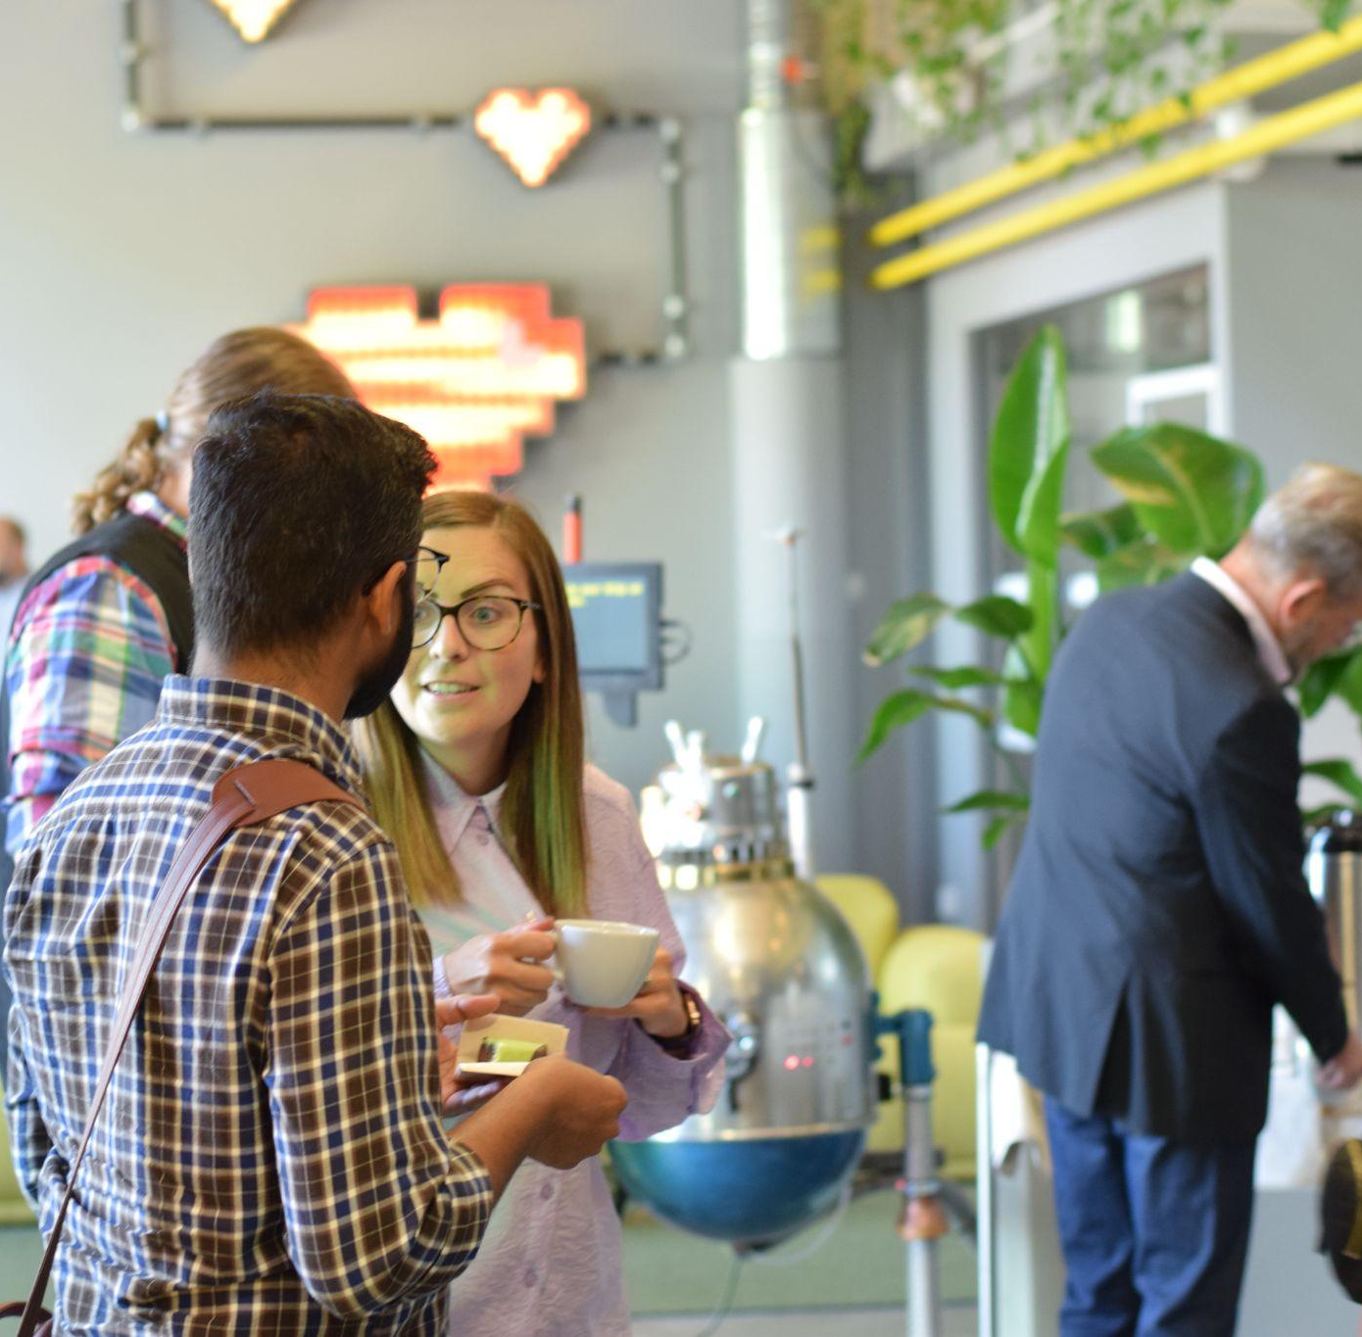
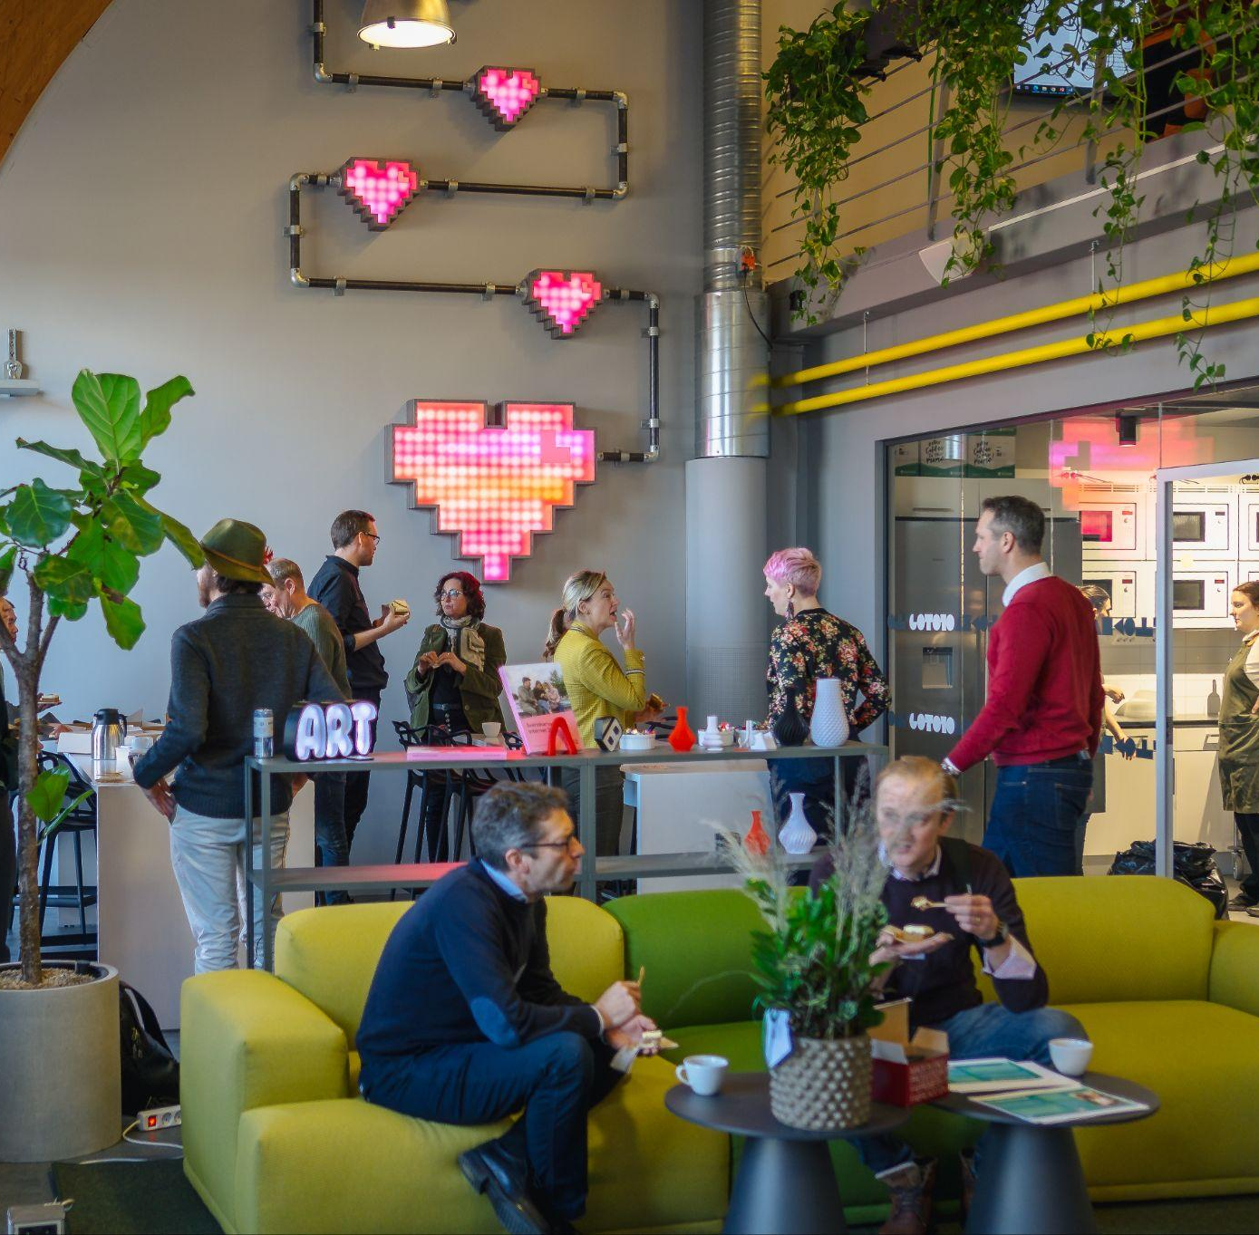
“We believe we can both benefit from collaborating with other industries and contribute with our own experiences. It’s about learning from each other while sharing what we know.”
Björn Rydberg, Industrial Cyber Security Officer at Siemens Energy - members of Cyberly.
Membership that matters
“For me, the value of the network became very tangible at the IoT World breakfast. Christian and I just happened to sit next to each other, and that led to this idea that we are now taking forward. That is by far the greatest value.”
Christoffer Johannesson, CEO Dyno Robotics - members of IoT World.
“Connecting people is important - that’s when you can discover the things that create real magic. It’s a great idea to organize this kind of event, where you take an hour and simply meet.”
Christian Sahlén, CEO, Actia - members of IoT World.
Notes:
Citat från Björn kommer från den här artikeln: https://linkopingsciencepark.se/siemens-energy-ansluter-till-cyberly-for-samverkan-och-kunskapsutbyte/
Citat från Christoffer och Christian kommer från den här artikeln: https://linkopingsciencepark.se/48776-2/

Slide 20
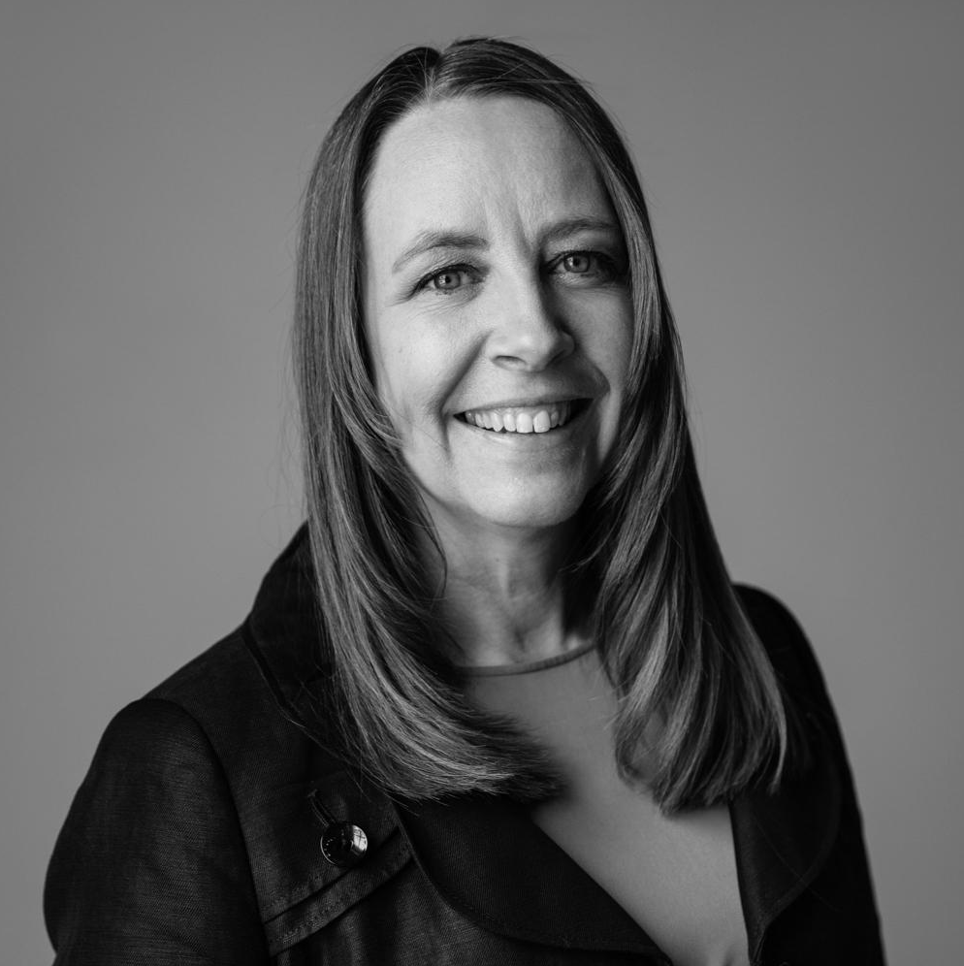
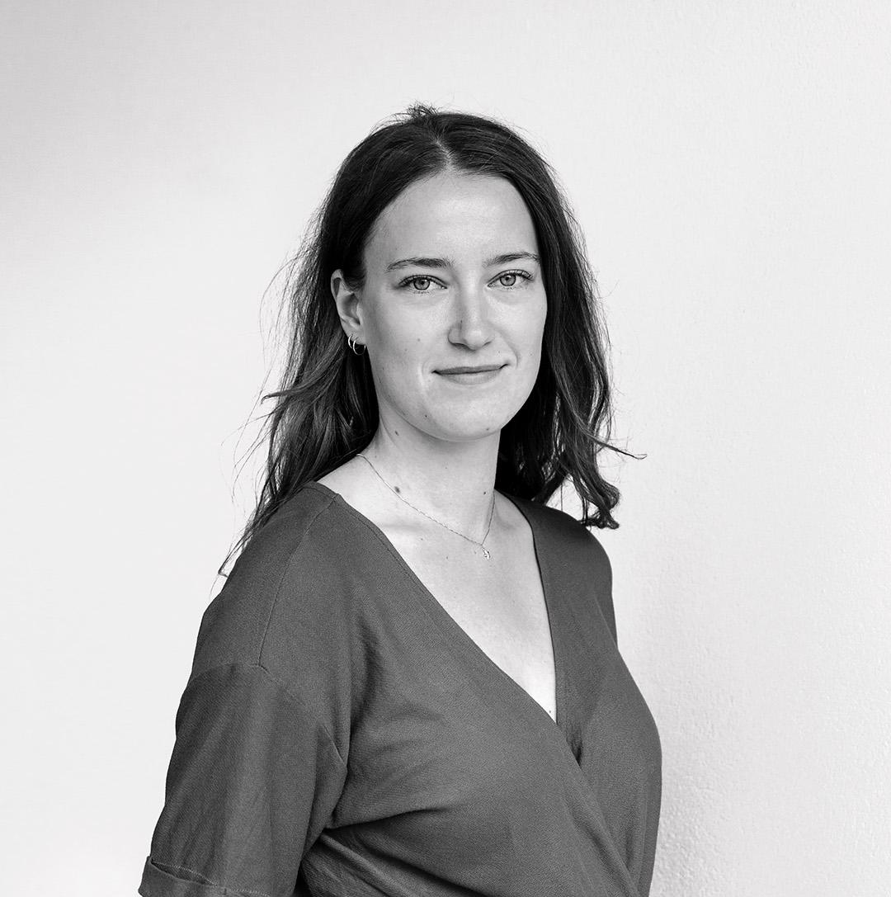









9/10
“The test environment is key to the testbed vouchers' value.”
Testbed vouchers
As a part of the project Linköping Climate Neutral 2030, the testbed vouchers are handed out to solutions or products within the sustainability area.
would not have been able to complete the test without the testbed vouchers.
“We wouldn't have been able to find the right test environment or partners on our own.”
The test environment scores 4.9 out of 5, marking it as extremely valuable.
Ulrika Johansson
Project Manager
“We are now able to offer a solution and describe the process to our future customers.”
“The testbed vouchers are a door opener!
It’s an opportunity to collaborate and test your solution within the City of Linköping."
100%
Julia Bergman
Communications Manager
would recommend others to apply for a testbed voucher.
4.6 out of 5 report that they gained concrete lessons from the test.
17
Edeva
Dubblett AB
SeaPattern
Buildility
Heation
Rexcel Technologies
A part of Linköping Climate Neutral 2030
Devair
Invisense
DAZOQ
Envista
Heation
SeaPattern
Signostium
TogetherTech/
Wiotech
AKKR8
Ajaxon Consulting
Nano Textiles Solutions
Kuikka & Company
Visiarc
Deepoid
companies granted vouchers

Slide 21
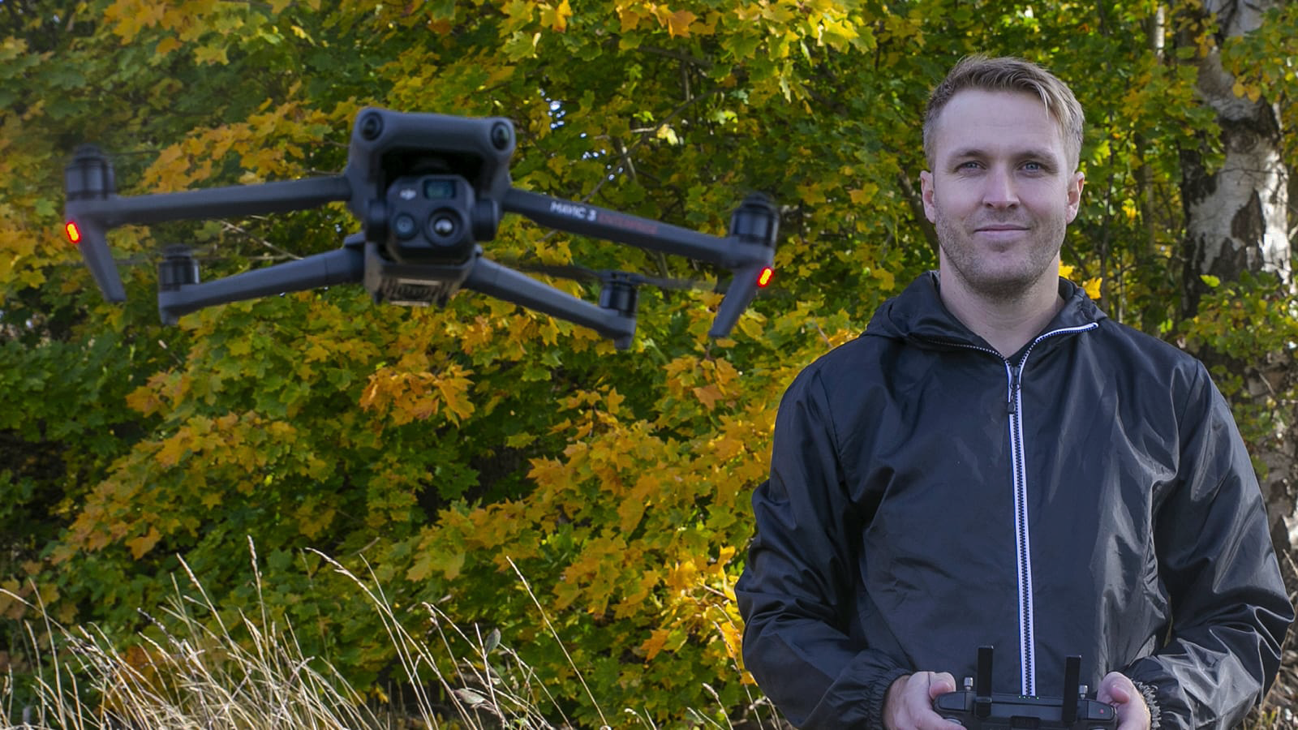
Smarter inspections from the sky – with a little help from AI
Inspecting roofs and façades is often risky, expensive and time-consuming. But with the help of a testbed voucher granted through Linköpings Draknäste, Ajaxon Consulting set out to change that – using drones, thermal cameras and AI.
Together with local property owners Lejonfastigheter, Sankt Kors and Stångåstaden, Ajaxon tested whether drone-based inspections could detect damage, water leaks or heat loss more efficiently.
“Through Linköping’s draknäste, we got several property owners on board, which was amazing,” says Viktor Ajaxon, co-founder of Ajaxon Consulting.
“We got access to real buildings and real data. Without that, we wouldn’t have had a proper environment to test the model in.”
Inspiring Solutions Award 2025
The Inspiring Solutions award, handed out by IASP, highlights successful initiatives from science parks and innovation environments worldwide. In 2025, Linköping Science Park was awarded for the work with the test bed voucher program.

Slide 22
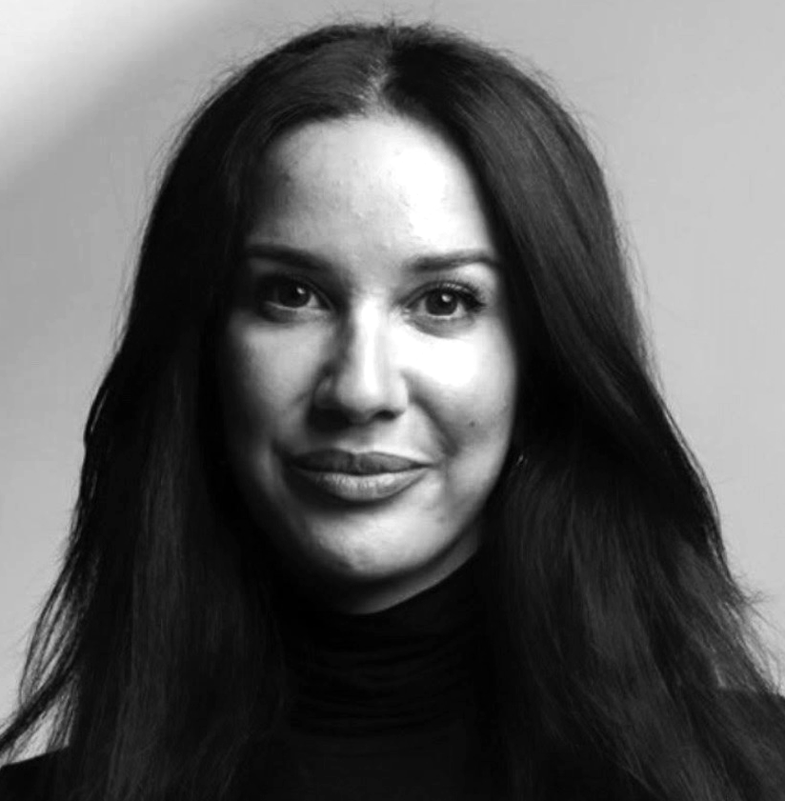
Funding that fuels
Distributed innovation checks
“Opportunities in Sweden were limited, as the process was both time-consuming and costly.” After three years of work, Alaa was close to giving up—until the innovation voucher arrived.
“I can truly say that the innovation voucher literally saved the company.”
2025
10 vouchers for a total of 1,1 MSEK
2024
17 vouchers for a total of 1,7 MSEK
​​Alaa Al-sahli, CEO and founder of Allaiter Textile AB, started her company out of a deeply personal need: to relieve the pain and frustration often experienced during breastfeeding. After four years of dedicated work, her innovative product Mamelle—a portable heating insert for breastfeeding breasts—is finally ready to launch. The decisive turning point that made this possible? A significant innovation voucher.
2023
37 vouchers for a total of 2,7 MSEK.

Slide 23

The launch of Defense Hub Sweden:
Mobilizing to strenghten innovation for a stronger total defense
Defense Hub Sweden is Östergötland’s joint initiative to accelerate the national total defense. Through collaboration, research, and innovation, we bring together civil technologies and solutions to strengthen defense resilience.
“…innovation must begin where military challenges actually arise, i.e. within operational units. This points to a bottom-up approach, in contrast to decades of experience based on the exact opposite — top-down structures. This approach requires regional meeting places where academia, industry, and the total defence system can come together. Defense Hub Sweden, which includes the Helicopter Wing, constitutes a critical resource for unlocking innovation at the pace demanded by the current security environment. Now is the time to act.”
Mats-Uno Runeson, Deputy Commander of the Helicopter Wing, commenting on the Swedish Government’s Total Defence Bill 2025–2030.
“The launch of Defense Hub Sweden was a thought-provoking and inspiring day that immediately led to new, valuable connections. One is struck by the depth of expertise in the region and by the strong opportunities we have to contribute something meaningful for Sweden. What began as an initial exchange of ideas over a cup of coffee has quickly developed into a concrete collaboration.”
— Lisa Åbom, CEO, Nira Dynamics.

Slide 24
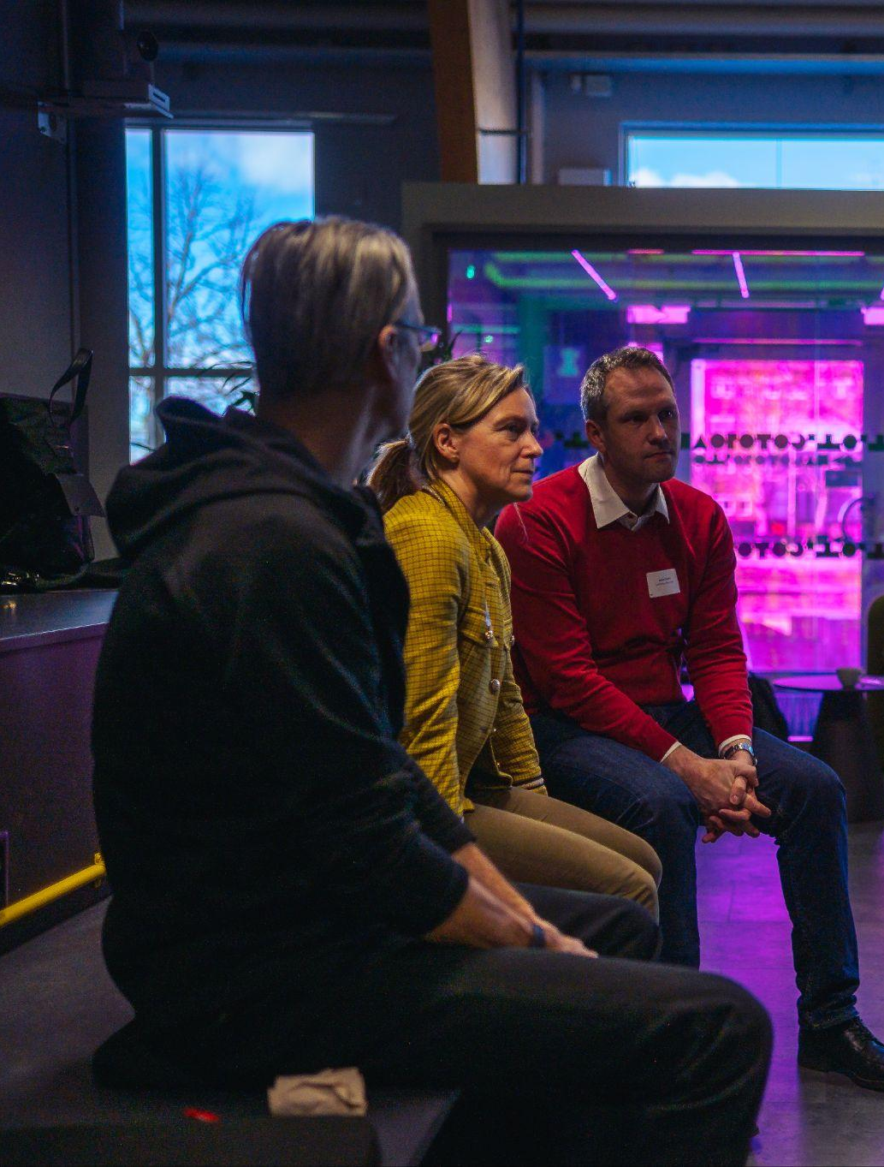
5 collaborations with Linköping Municipality
Testbed vouchers, part of Linköping Climate Neutral
Brilliant mentors of the future
iCapital innovation fund
Mjärdevi Place Innovation
Student workers

Slide 25
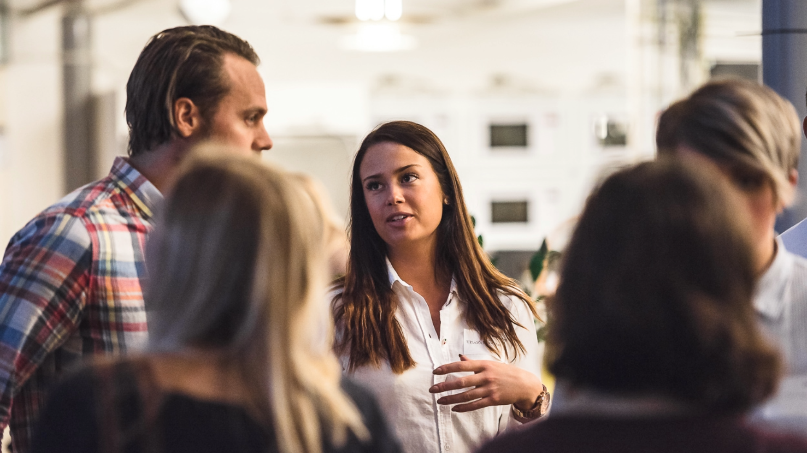
The people, the processes & the pulse
of Linköping Science Park

Slide 26
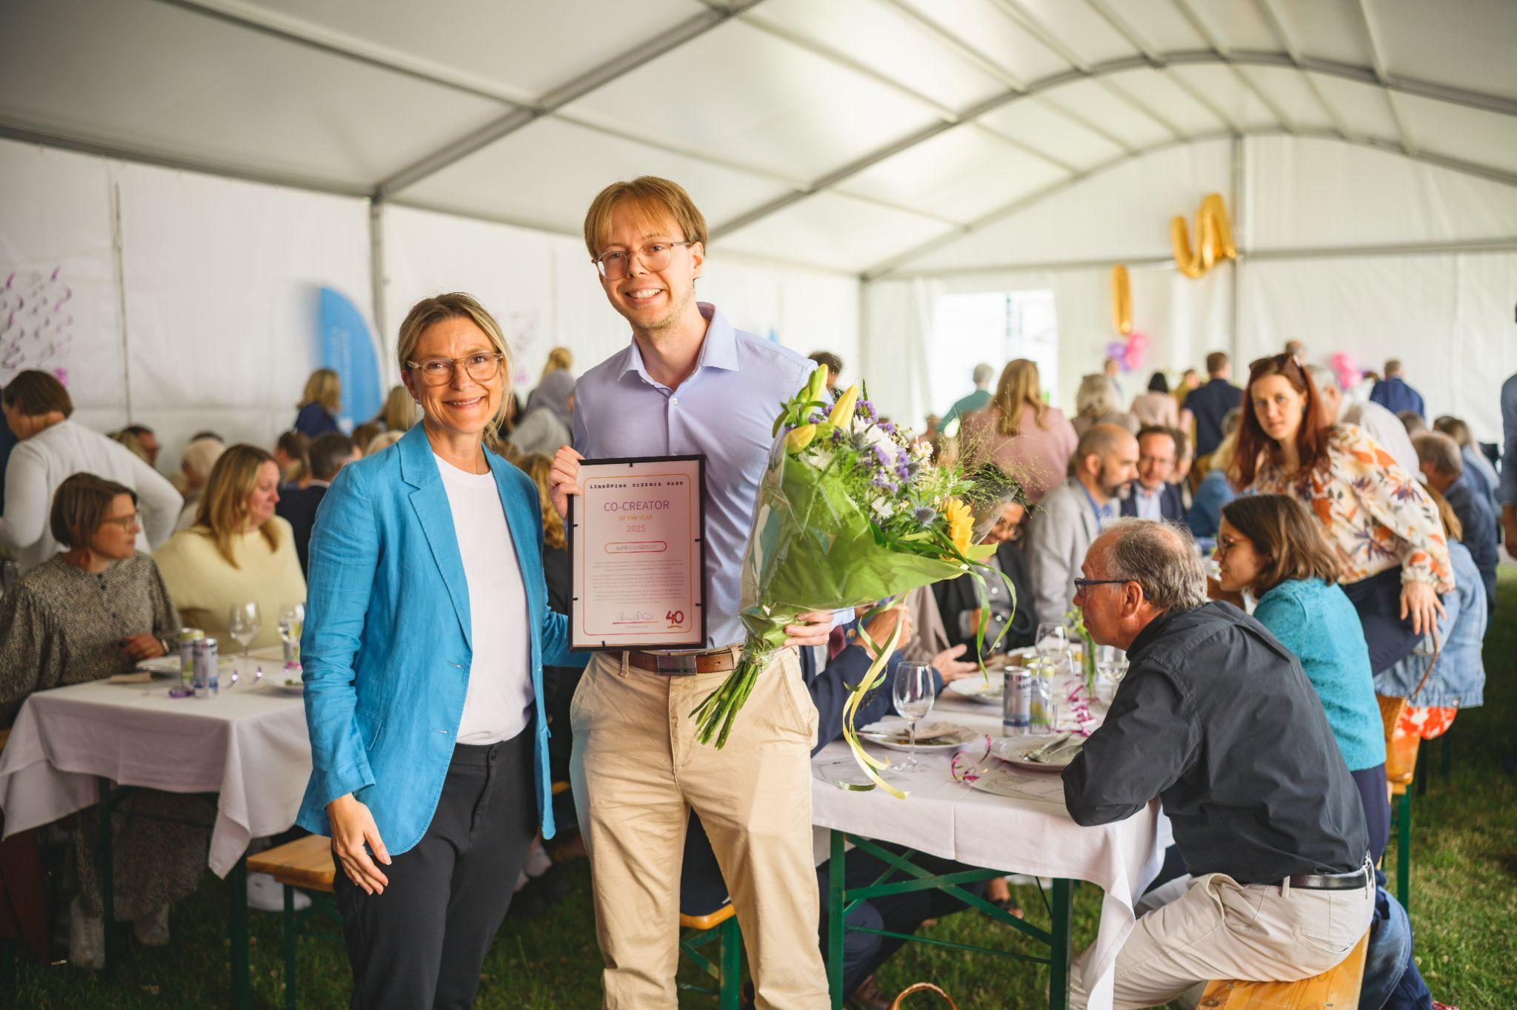
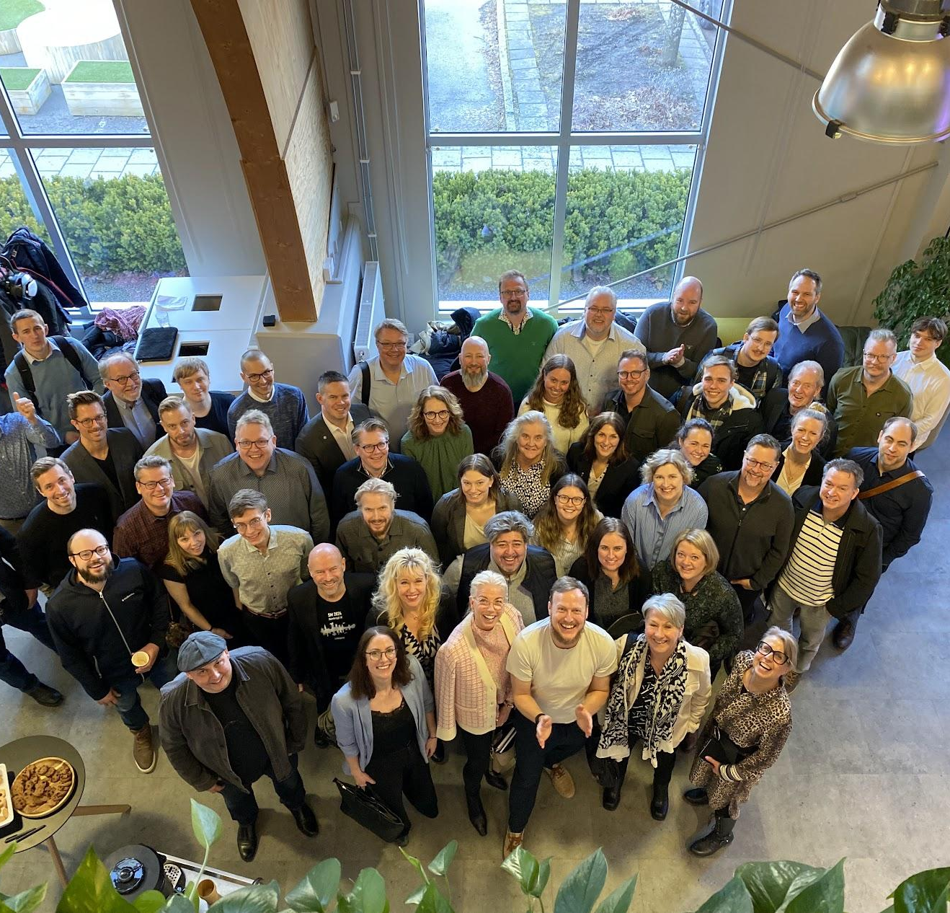
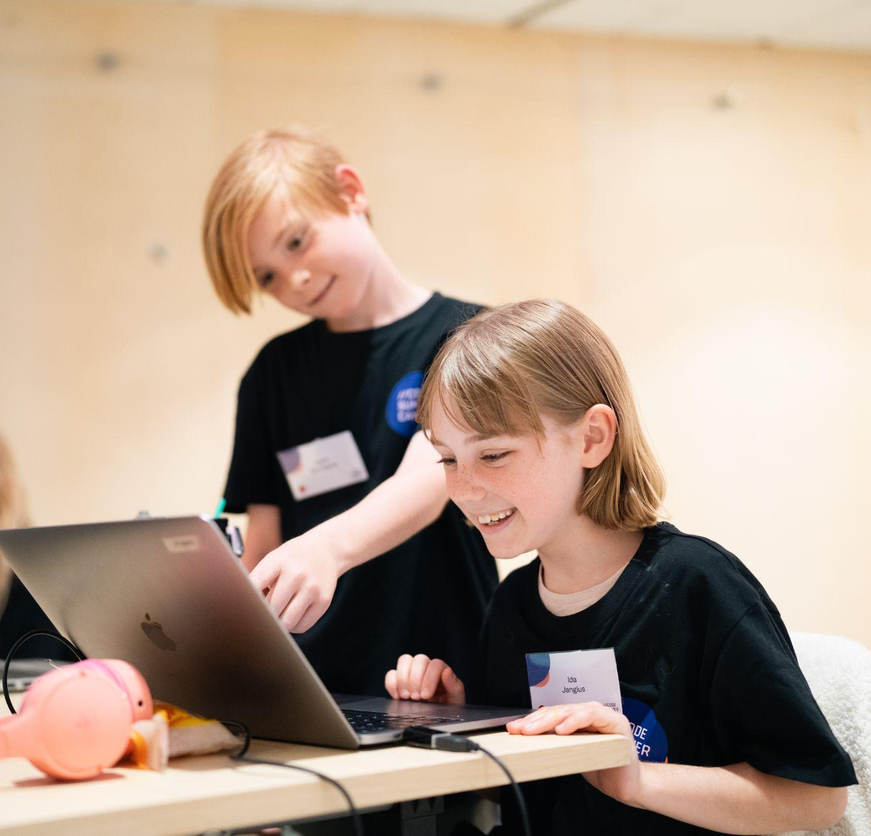
For the 11th year in a row, Code Summer Camp inspired kids and teens to explore tech and programming. This summer, we welcomed over 300 participants – the highest number so far.
The camp went national with digital hubs in cities like Mjölby, Trollhättan and Gothenburg.
people
pulse
The local tech visionary Alfred Sundstedt arranged Hackaping – a bold, collaborative AI hackathon at Linköping University.
For his initiative and passion for co-creation, Alfred was awarded Co-Creator of the Year by Linköping Science Park.
With its deep roots in tech and research, Linköping is stepping up to become Sweden’s AI hotspot. Through AI East, we along with regional partners are building a cross-sector network to help companies turn AI into real value.
processes

Slide 27
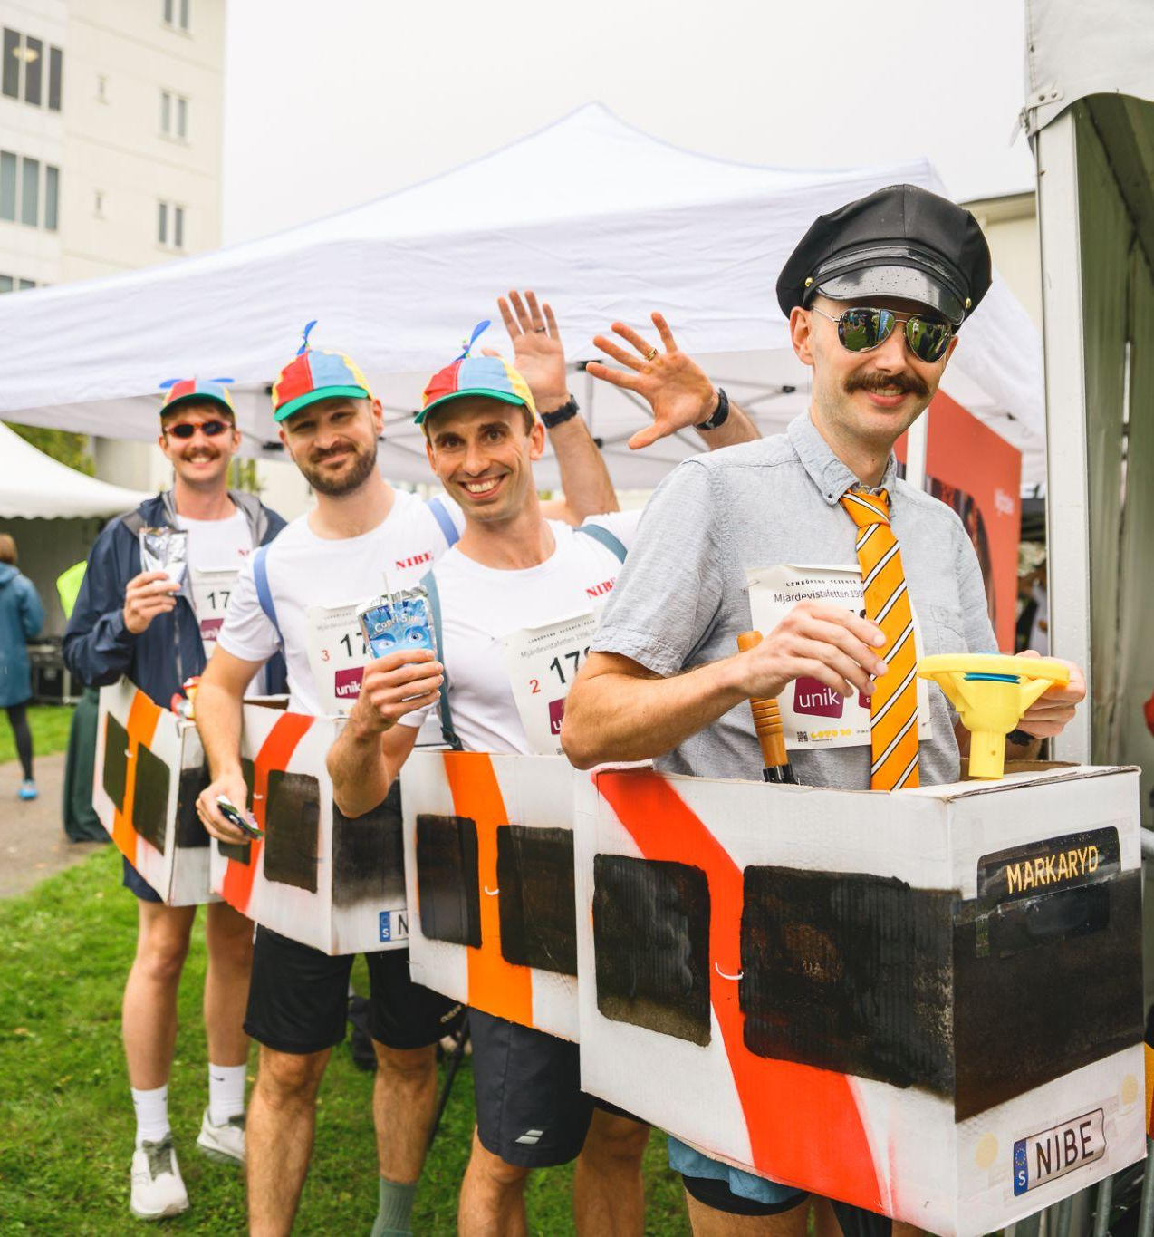
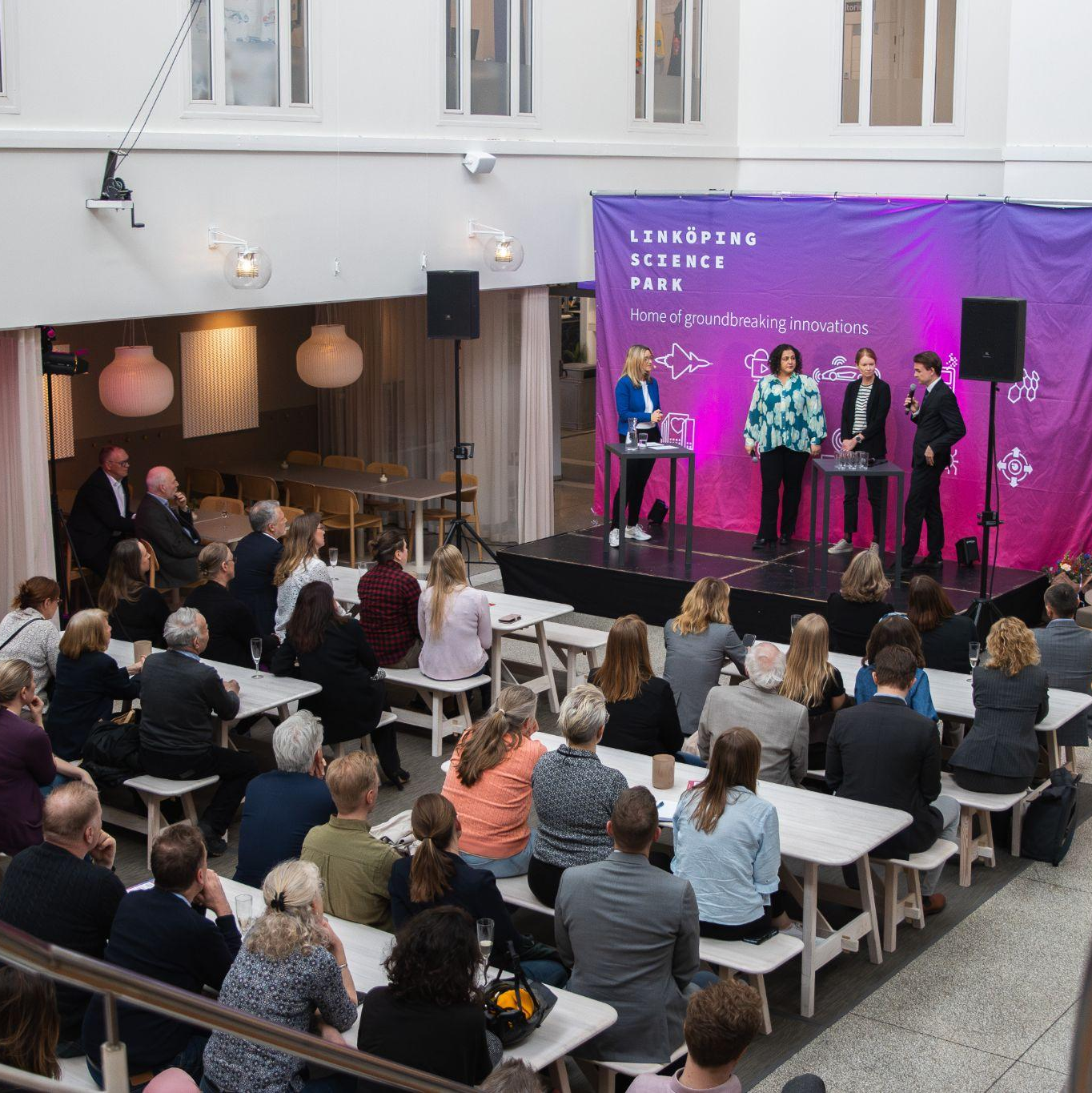
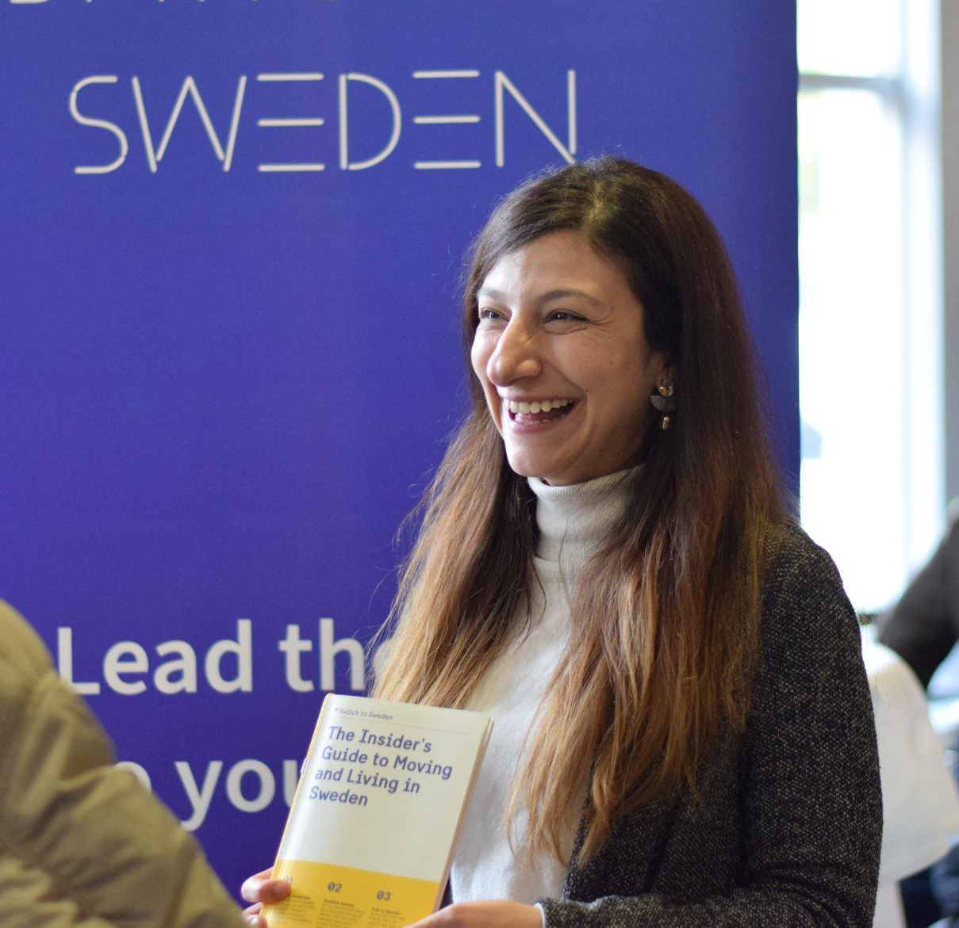
6940
visitors at our events
2142
visitors at our profile events
153
events hosted by us
Notes:
Siffrorna avser event under 2025.

Slide 28
A region of winners
Crister Stark, Väderstad
Kommendörsgraden av Kungliga Vasaorden
Botanic Games
Winner at Swedish Game Awards: Best Technology (New Talent) och Best Design (New Talent)
Mari Ahlquist, iMatrics
Listed by Resumé as one of '99 Women Taking Marketing and Tech to the Next Level'
Arboair
Winner InfraAwards
Dyno Robotics
Winner at Blooloop Innovation Awards: Guest Journey
Jessica Öberg, Combitech
Awarded CEO of the Year in the large company category
Axel Larsson och Sofia Hallman
Awarded the SEB innovation scholarship
Renasens
Winners at H&M Foundation Global Change Award
Olof Brüer och Torbjörn Kronander, Sectra
Näringslivsmedaljen 2025
Ellinor Eineren, Agricam AB
Listed on 4potentials’ annual ranking of Sweden’s top change leaders
IFS
Linköpings näringslivsdiamant
Spotscale
Winners at Business Arena Tech Awards 2025
AMRA Medical
Listed by TIME Magazine as one of the ‘World’s Top HealthTech Companies’
Polar Light Technologies
SKAPA 2025
NIRA Dynamics AB
Winners at Bosch Global Supplier Award 2025
Jenny Arpe
Master of Science graduation award in memory of Christopher Polhem
Placebrander
The Insider's Guide to Recruiting International Talent
Dukaten
Winners at EPA Awards: Best innovative parking solution
Worldish
Rewarded by Nyföretagarcentrum
Westra Materials
On the 33-list from NyTeknik
Cellfion
Winners at Capgemini Nordic Sustainability Tech Award 2025
MicroDri
Winners at Trätoppen 2025
On the 33-list from NyTeknik
Anna Björklou
Winner at Sogetis #addher awards: Role model

Slide 29
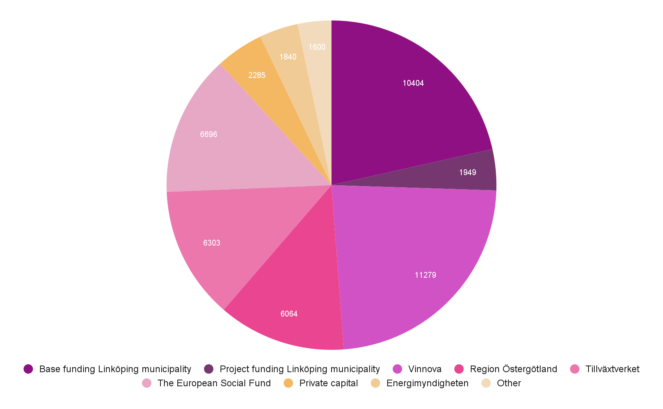
Funding 2025
Total revenue 48 421 000 SEK.
Amounts are shown in million SEK.

Slide 30
International engagement
of Linköping Science Park

Slide 31
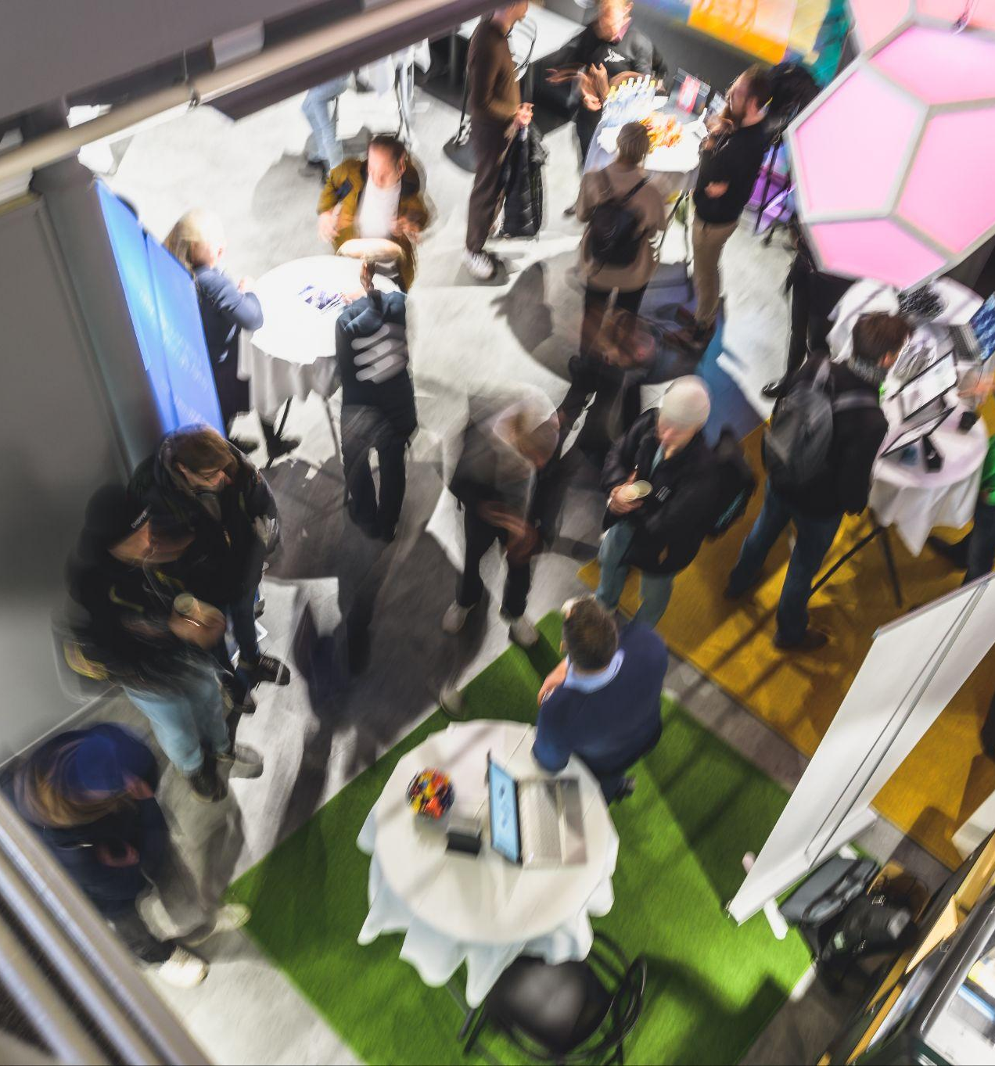
In a broader context:
The value of Science Parks - locally and in the world
Linköping Science Park is a proud member of the International Association of Science Parks and Areas of Innovation (IASP) – a global network that helps us create value for our companies far beyond regional and national borders. Let’s look at what the members of IASP offer!
We are a member of the Swedish Incubators & Science Parks Association (SISP), collaborating with science parks nationwide to support and strengthen Sweden’s innovation and competitiveness as a tech nation.

Slide 32

Rooted in Linköping, connected worldwide
Linköping Science Park is a proud member of the International Association of Science Parks and Areas of Innovation (IASP) – a global network that helps us create value for our companies far beyond regional and national borders.
Lena Miranda was elected President of IASP in 2023 and served in that role through 2025, completing a two‑year term.
Prior to becoming President of IASP, she served two years as Vice President and also held leadership roles within IASP’s European division.
ANDORRA, ANGOLA, ARGENTINA, AUSTRALIA, AUSTRIA, AZERBAIJAN, BELGIUM, BOTSWANA, BRAZIL, BULGARIA, CAMEROON, CANADA, CAPE VERDE, CHINA, CHINESE TAIPEI, COLOMBIA, CROATIA, CUBA, CZECH REPUBLIC, DENMARK, DOMINICAN REPUBLIC, ECUADOR, ESTONIA, ESWATINI, FINLAND, FRANCE, GERMANY, GREECE, HUNGARY, ICELAND, INDIA, IRAN, IRELAND, ITALY, JAPAN, KENYA, KOSOVO, LATVIA, LITHUANIA, LUXEMBOURG, MALAYSIA, MEXICO, MOLDOVA, MOROCCO, THE NETHERLANDS, NIGERIA, NORWAY, OMAN, PAKISTAN, PALESTINE, PANAMA, PARAGUAY, PERU, POLAND, PORTUGAL, QATAR, ROMANIA, SAUDI ARABIA, SERBIA, SINGAPORE, SLOVAKIA, SLOVENIA, SOUTH AFRICA, SOUTH KOREA, SPAIN, SWEDEN, SWITZERLAND, THAILAND, TURKMENISTAN, TÜRKIYE, UKRAINE, UNITED ARAB EMIRATES, UNITED KINGDOM, UNITED STATES OF AMERICA, URUGUAY, UZBEKISTAN, VENEZUELA, VIETNAM
1984 created | 350 members | >115k companies | 81 countries
42 world conferences | 200 regional events | 6 regional divisions | 2 offices

Slide 33
The offer of IASP members worldwide
Supporting new and growing companies 96% of science parks offer incubation services 76% manage full incubation or acceleration programs
Going global 83% support international expansion 58% help companies with internationalisation strategies
Attracting the right talent 85% assist companies in finding and attracting top talent
Turning knowledge into business 73% work actively with knowledge transfer – helping academic research reach the market
Creating connections that matter 86% provide networking, events and community-building services that foster co-creation and innovation
Source: IASP GLOBAL SURVEY Science and technology parks, innovation districts, areas of innovation and other organised innovation spaces throughout the world, 2024.

Slide 34
Looking ahead to 2026 and beyond
Looking ahead, Linköping Science Park will contribute to a growing Linköping with a strong business sector and more people in employment by strengthening the region’s innovation and transformation capacity and further positioning Linköping as a leading tech hub with increased attractiveness and international relevance.
We will accelerate technology transfer and diffusion so that more companies can turn AI, IoT, cybersecurity and advanced digitalisation into real products, services and business growth. By reinforcing our strategic platforms – IndX, IoT World, Cyberly, AI Öst as well as ACS East Node and Defense Hub Sweden – we will scale demand-driven initiatives and increase the number of national and international collaborations.
At the same time, we will broaden participation through talent and skills programmes for new target groups and lifelong learning. We will strengthen the scaleup support in East Sweden by a closer collaboration with regional actors.
Finally, we will secure long-term delivery capacity through striving for stable funding, strategic collaborations and a strong organisation towards 2030.
Lena Miranda CEO, Linköping Science Park

